Slide 1
l
DSG Data Sync Initiative and the
GXS Catalogue

Slide 2
Agenda
Introduction
Why Data Sync for DSG
What is Data Sync
DSG and GXS Required Attributes
Using the GXS Catalogue for DSG
Utilizing provided resources for the DSG initiative
Documentation and Support
Q & A

Slide 3
Why Data Sync for Dick’s Sporting Goods

Slide 4
Dick’s Sporting Goods Data Synchronization Initiative
Our goal:
To create a more efficient way for Dick’s Sporting Goods to receive your product data by eliminating the numerous touch points for data collection by utilizing the GXS Catalog to establish a single source systemic method
Key Objectives
Increase speed to market
Improve product data accuracy
Realize supply chain efficiencies for vendors as well as retailers
Establish GXS as the Recommended Catalogue Provider for Dick’s Sporting Goods
Experience with leading retailers
Multiple Publishing Options for loading data into the Catalogue
EDI , XML, Web & CSV options

Slide 5
Data Synchronization Benefits
Eliminate points of failure—replace paper and spreadsheets
Product is setup is systemically presented in Dick’s Sporting Goods systems with minimal user interaction
More efficient generation of purchase orders by DGS to our vendor community
Efficient, repeatable and controlled processes for New Product Introduction (NPI) and Product Changes
Availability of consistent product master data for all business processes and channels
Vendor product data will be available at the optimal time in the product lifecycle
And finally, faster Item Setup which means…
Increased speed to market - enabling us to get your products on the web and to our shelves faster!

Slide 6
What is Data Sync

Slide 7
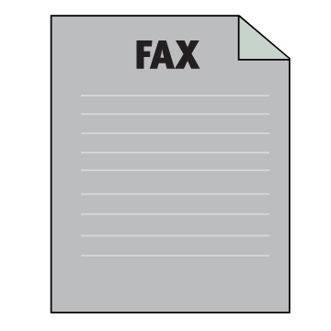
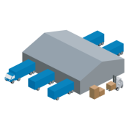
Manual item setup = supply chain inefficiency
Vendor A
Large Retailer A
EDI
Postal Mail
Retailer
New Item Form
Distributor B
EDI
Small Shop B
Supplier C
Wholesaler D
Telephone
Specialty Retailer C
Purchase
Order
Facsimile
Manufacturer E
Large Retailer D
Proprietary
Spreadsheet
Web Portal
Vendor F
Online Retailer E
XML
Redundant expenses
Erroneous purchase orders
Charge backs/write-offs
Retailer
New Item Form
Telephone
Incorrect invoices
Merchandise delays
Lost sales
XML

Slide 8
Data quality challenges
New Item
Introduction
Merchandising
And Marketing
Dimensions
And Logistics
Price Change
Management
Promotional
Pricing
Product and Price Data Quality Challenges
Item attributes
Proprietary product identification systems
Descriptive data for multiple channels
Lead time and quantity requirements
Logistics information for freight optimization
Price and promotional data
Customer specific pricing scenarios
Price-date window agreements
Price brackets/quantity buy conditions
Ads, markdowns and other deductions

Slide 9
What is GXS Active Catalogue?
GXS Active Catalogue is the world’s leading product data synchronization application, allowing marketers, manufacturers and suppliers to share their latest product information such as price, packaging, color, size and more than 600 additional product and image attributes with retailers. It provides extensive data validations and comprehensive data attribute support. GXS Active Catalogue enables better management of new item introductions and item maintenance processes.
Key Statistics:
Over 150M items stored
Over 600 attributes
Over 5,500 suppliers/manufacturers/distributors
Over 180 retail hubs

Slide 10
GXS Active Catalogue Data synchronization for your supply chain
Retailer
integration options
Vendor
integration options
Real-time
(Web Services)
Real-time
(Web Services)
Large Vendors
EDI/XML
EDI/XML
GXS
Mid-Tier Vendors
Web UI
Text File upload
Active Catalogue
Text File
Download
Web UI
Small Vendors
Flexible and comprehensive capabilities increase operational efficiencies and ensure compliance with diverse trading partner requirements.

Slide 11
DSG and GXS Required Attributes

Slide 12
Data Hierarchy and Attributes
With over 600 GTIN-level Attributes and Images
UPC/EAN/GTIN NRF Size Code Discontinued Date
Color Description Published Cost UPC Type
NRF Color Code MSRP Pre-Pack Components
Size Description Change Date & Quantities
Min. Order Quantity Booking Date Countries of Origin
Max. Order Quantity Availability Date Fabric Description
Length Width Height
Length UOM Width UOM Height UOM
Weight Cube Size Mfgr’s Pack Size
Weight UOM Cube UOM Mfgr’s Pack Size UOM
Reorder Flag Lead Time Point of Origin
Seasonal Avail. Flag Lead Time UOM
NMFC Code Harmonize Code Quota Category
Haz. Mat. Code/Desc. Name and Desc. Warranty
Trade Name Logistics
Nutritional Information
Catalog
(Vendor)
Selection
Codes
Products
(Styles)
UPCs or EANs

Slide 13
GXS and DSG Required Attributes
GXS Required Attributes
Seven attributes are required for you to load information to the GXS Catalogue.
With out these attributes, you will not be able to load an item into the Catalogue.
Product ID Number | Product ID Description
GTIN (or UPC)
NRF Color Code | NRF Size Code
NRF Color Description | NRF Size Description

Slide 14
GXS and DSG Required Attributes
DSG requires an additional 26 attributes to load an item to their system which can be supplied while loading the item into the Catalogue.
All Attributes can be loaded to the Catalogue by any of the methods available
EDI 832
Web Services
CSV Template
Web/UI

Slide 15
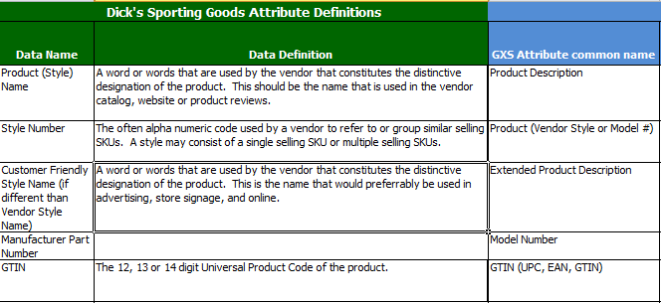
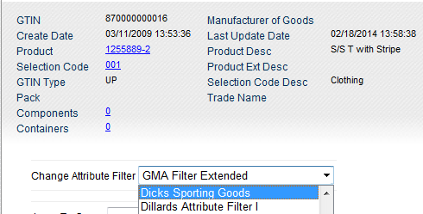
GXS and DSG Required Attributes
A list of the DSG required attributes is available to you on the program landing page
An Attribute Filter is also available to apply in the Catalogue that will enable you to only see the DSG required attributes.

Slide 16
Using the GXS Catalogue for DSG

Slide 17
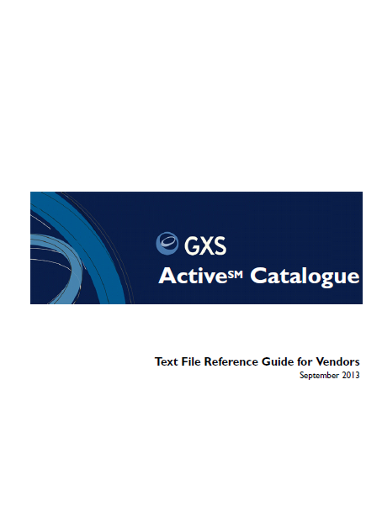
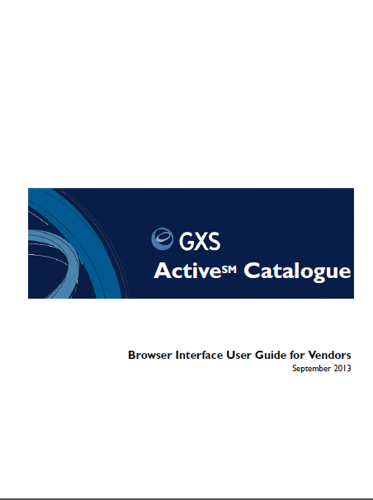
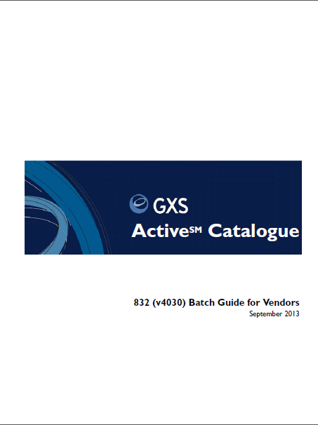
Using the GXS Catalogue for DSG
Text File
Web Browser
EDI 832
Extensive documentation available to assist you, no matter what method you prefer.

Slide 18
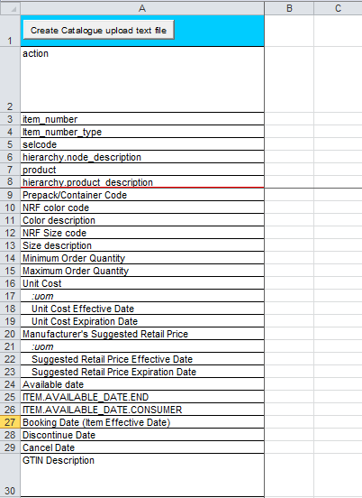
Using the GXS Catalogue for DSG
For those users who choose to load their item information with the CSV template, there is a template specifically for the DSG program.
This template is available on the DSG Program page at: http://www.gxs.com/dsg or a standard CSV template is available in the Catalogue Documentation

Slide 19
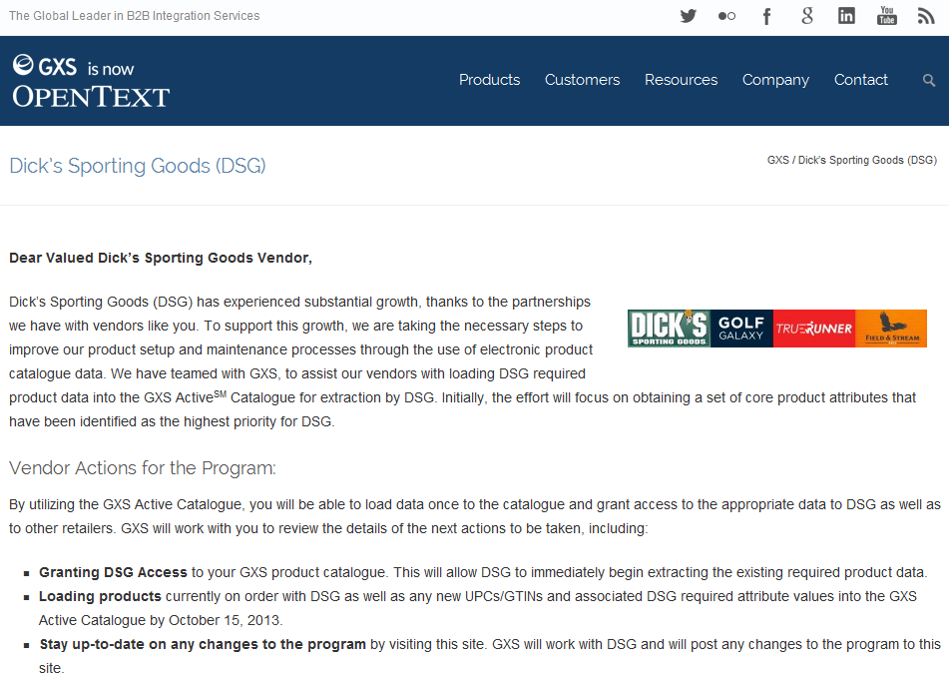
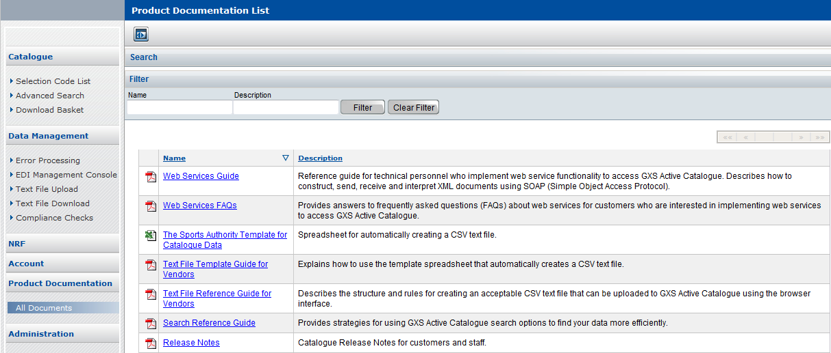
Using the GXS Catalogue for DSG
The CSV file is available on the DSG landing page
Or on the Catalogue Documentation tab in the Catalogue

Slide 20
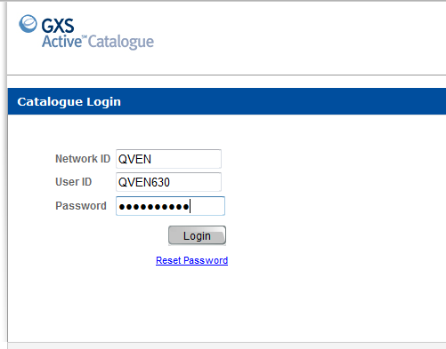
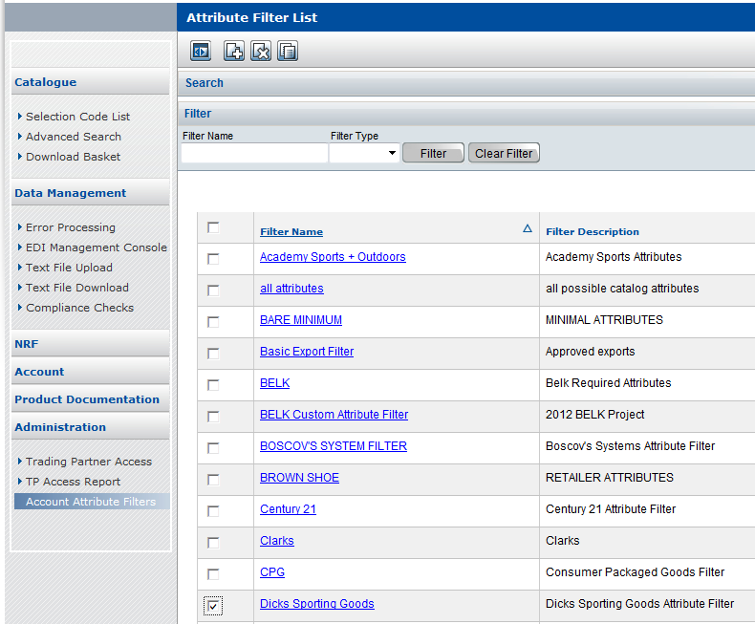
Using the GXS Catalogue for DSG
When using the UI, set the Attribute Filter to DSG
Log into the GXS Catalogue UI
Select “Account Attribute Filter”, select Dicks Sporting Goods and click “Apply”

Slide 21
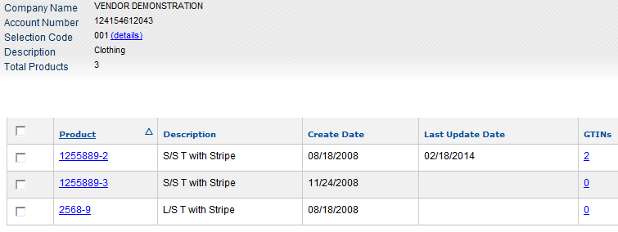
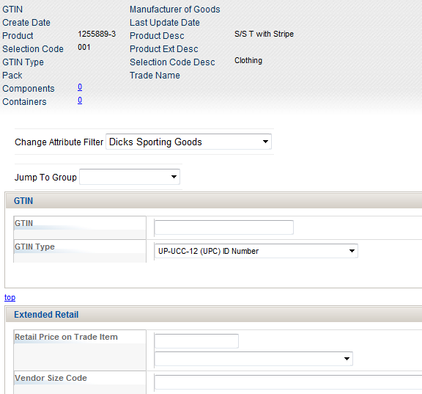
Using the GXS Catalogue for DSG
Add your products as you normally do.
Only Attributes that are applicable to Dicks Sporting Goods will be shown on the screen.

Slide 22
Using the GXS Catalogue for DSG
If you are using the 832 to load or update your data, be sure to consult the DSG/GXS cross reference guide so that you include all of the correct attributes for your items!
*These are both available on the DSG Program Page!

Slide 23
Required Products and Granting Access
DSG want to receive all New GTINs/UPCs that are available within their store and also on line direct to customer items.
DSG would like “Unrestricted” access granted to them-
DSG Account ID = 127242733083
A step by step document on how to grant access can be found on the landing page.

Slide 24
Documentation and Support

Slide 25
Documentation and Support
GXS Contact Details -
If you are an existing customer and need assistance in granting access you can call our support group at: +1 877-446-6847 Option 2, Option *, Option 4, Option 1 or email at cataloguesupport@gxs.com
If you wish to get signed up with the GXS Catalogue, you can call out Sales Group at +1 800-334-2255, option 3 or email at sales@gxs.com
DSG Contact Details –
merchdata@dcsg.com

Slide 26
Documentation and Support
For all of the latest information and documentation pertaining to the DSG Data Sync Initiative, please visit the DSG Landing Page at:
www.gxs.com/dsg
Questions about todays information?
Kenny.Terhurne@GXS.com

Slide 27
Questions

