Slide 1

Thank you for participating in the Belk & OpenText/GXS Extended Attribute Educational Webinar
The call will begin at approximately 2pm today and space is limited, so if you have troubles getting into the webinar, please listen in and the presentation will be available on www.gxs.com/belk next week
The line will remain silent until the start of the call
All lines will be muted. Any questions can by submitted via the Q&A section on Global Meeting menu (upper right-hand corner of your screen)
All submitted questions will be answered and posted to Belk’s Landing Page next week (www.gxs.com/belk)
This session will be recorded. The recorded session will be posted to Belk’s landing page next week (www.gxs.com/belk)

Slide 2
Extended Attribute Image Initiative
October, 2015

Slide 3
Agenda
Introductions
Belk – Our Brand
Belk’s Expectations
Extended Attributes
  GS1 Retailer Extended Attribute Requirement Matrix
  GS1 Extended Attribute Guide Release 2
How Vendors Use the Catalogue
  Providing Extended Attributes via the OpenText/ GXS Catalogue
Belk’s Requirements & Call Outs
Q & A

Slide 4

Introductions
  Colleen McCarthy- Vice President, Data Governance
  Audra Atkinson - Director, Merchandise Operation
  Vanessa Maybury- Director, Digital Content
  Meredith McBride – Director, Data Governance
  Jake Divjak– Customer Manager
  Don Wiener – Director, Retail Accounts

Slide 5
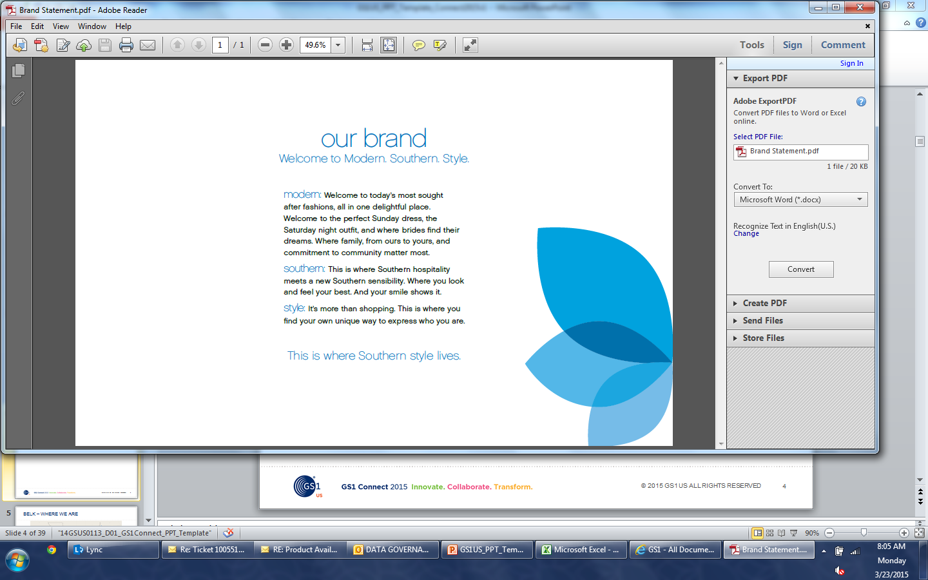
Belk

Slide 6
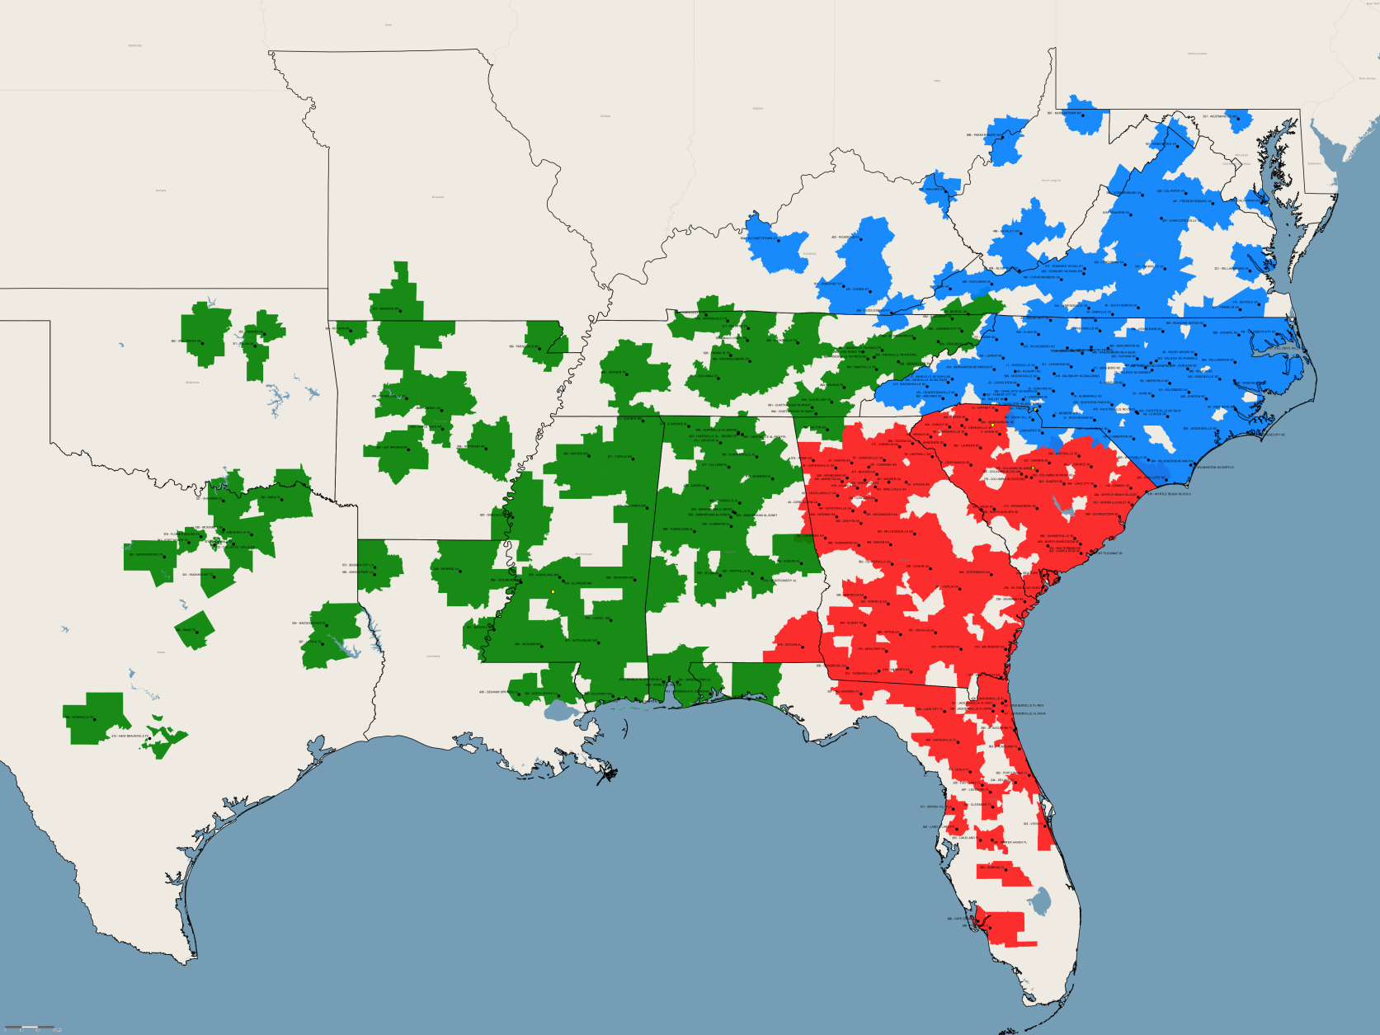
Belk – Where We Are

Slide 7
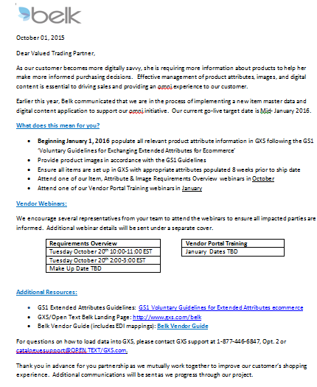
Belk’s Expectations
Extended Attribute Letter Notice
Start working with GXS to learn the upload Process
Visit OpenText/GXS Landing Page created especially for Belk’s initiatives: www.gxs.com/Belk

Slide 8
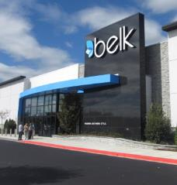




“Connecting with her, wherever she is”
Omnichannel is about our customer, who is at the forefront of everything we do.
OMNI
^
Modern. Southern. Style.
Stores
Belk.com
Social
Mobile

Slide 9

.
Extended Attributes:
  Impacts of Attributing
  Benefits: Populating Attributes
  GXS
  GS1 Documents and Tools

Slide 10
Impacts of Attributing
Business Function | Reasons
Ecommerce | Enhance Search Engine Optimization (SEO) Additional selling features improve sales Customers want more information for better purchasing decisions Automated process improves cycle time to website
Buying & Planning Merchants | Review image at time of PO entry Utilize attributes for enhanced reporting and allocation to stores
Supply Chain | Hazardous materials for package handling Dimensional/weight information for fast put away at FC Images assist FC associates with picking & packing customer orders
Stores | Images to help with store fulfillment and promotional event set up
Tax | Attributes to support various tax rules in store and online. For example, SPF is tax exempt in Texas
Legal | Necessary for complying with US Dept. of Commerce rules, i.e., animal fur name

Slide 11
Benefits: Populating Attributes GXS
Vendor Benefits | Belk’s Benefits
Consistent brand representation across all brands and retailers | Creates a homogenous customer experience for Omni-Channel
Lessens manual workload often done by local sales reps; information becomes centralized | Consistent format and receipt of information from vendors and reduces mistakes
Produces one set of attributes & images for all retailers | Eliminate judgment calls due to lack of data, i.e., assume fur is fake when it is real
Eliminates time mailing and tracking samples to send from one retailer to another | Less errors in matching images/samples and attributes to products
Shortens cycle time to Belk.com resulting in additional sales | Reduces cycle time to Belk.com resulting in additional sales

Slide 12
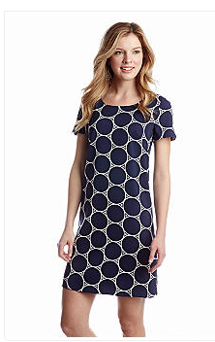
PO vs. Sales Attributes
Attributes necessary for PO:
Additional attributes that drive sales:
Attribute | Example of Attribute Value
Style Number | 0307J22
Style Description | Printed Sheath Dress
NRF Color Code | 400
Color Description | Navy/White
NRF Size Code | 00006
Size Description | 6
UPC Number | 0438528126115
Cost | $22.00
Retail | $74.00
Attribute | Example of Attribute Value
Brand | AGB
Neckline | Scoop
Sleeve Length | Cap sleeve
Closure | Button-and-loop
Length | 30”
Country of Origin | Imported
Collection Name | Southern Charm
Fabric Content | Polyester/Spandex
Care Instructions | Machine Washable

Slide 13
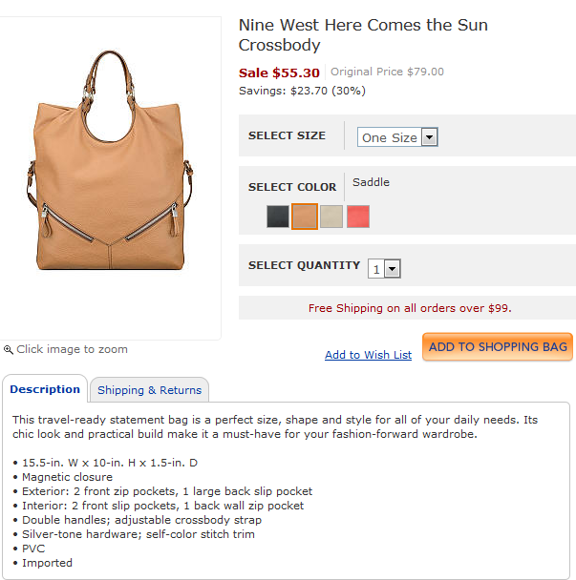
Additional Images Drive Sales
Additional images needed to show consumer the inside/outside of bag
Consumers would also like to see a mannequin shot
Visibility to the crossbody strap

Slide 14
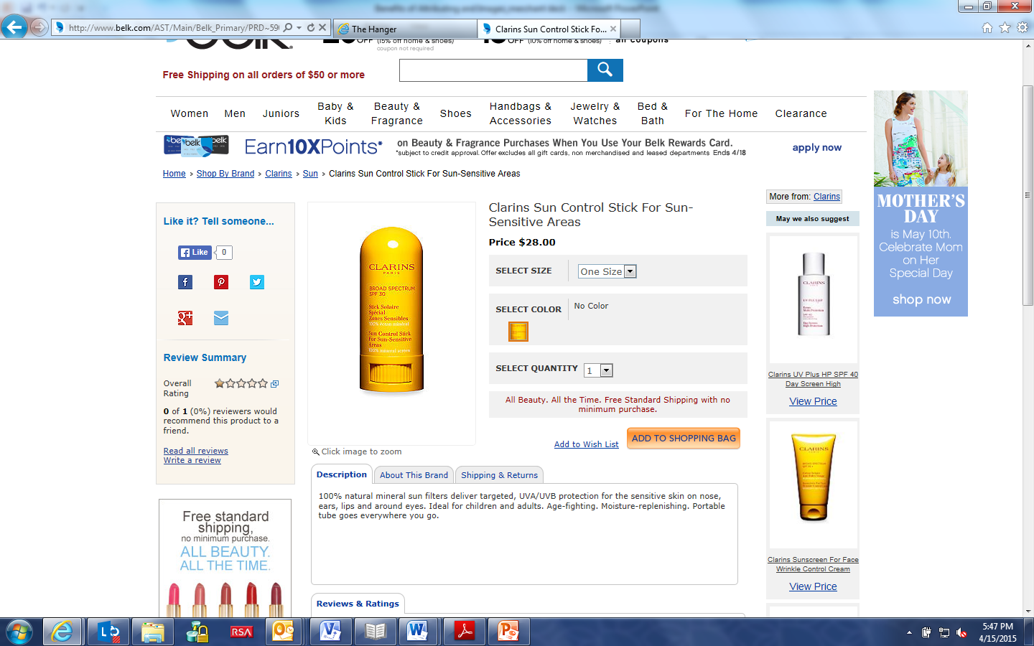
Content Supports Tax & Legal Requirements
An SPF attribute on this product is necessary to support state tax laws
Note: Item is was not populated with the actual size. Customer wants to know how many fluid ounces they get for the price

Slide 15
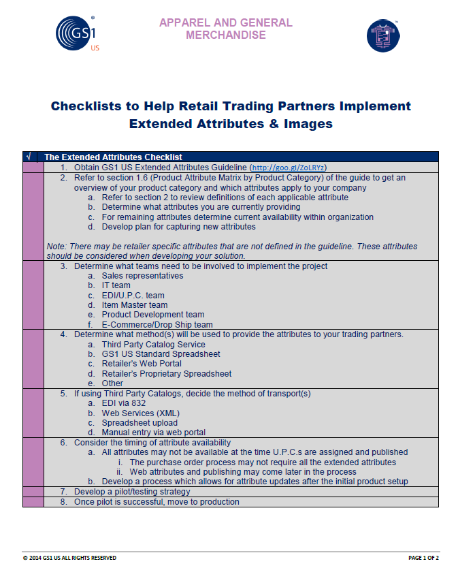
Preparing to Load Items into GXS
Visit the website www.gxs.com/belk for more information that can help you implement a strategy within your company
  Belk’s Extended Attributes Requirements
  GS1 Extended Attribute Guideline

Slide 16
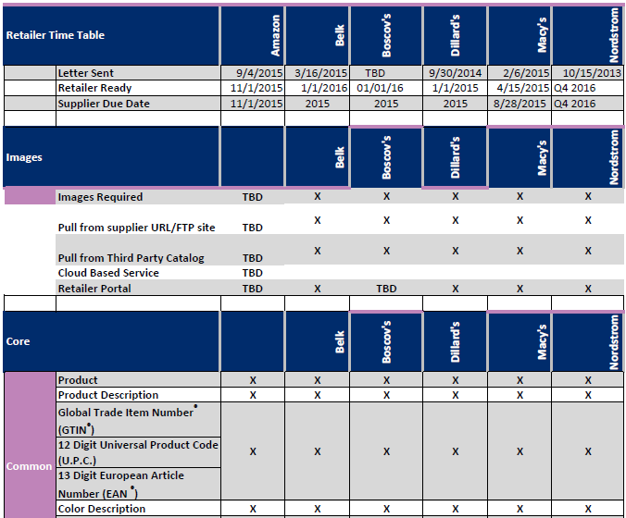
GS1 US Retailer Attribute Requirements Matrix
Outlines the expected trading partner timelines and attributes requirements
For more information, refer to www.gxs.com/Belk
  GS1 US Retailer Attributes Requirement Matrix

Slide 17
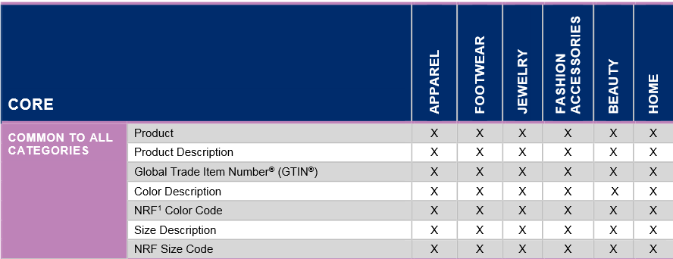
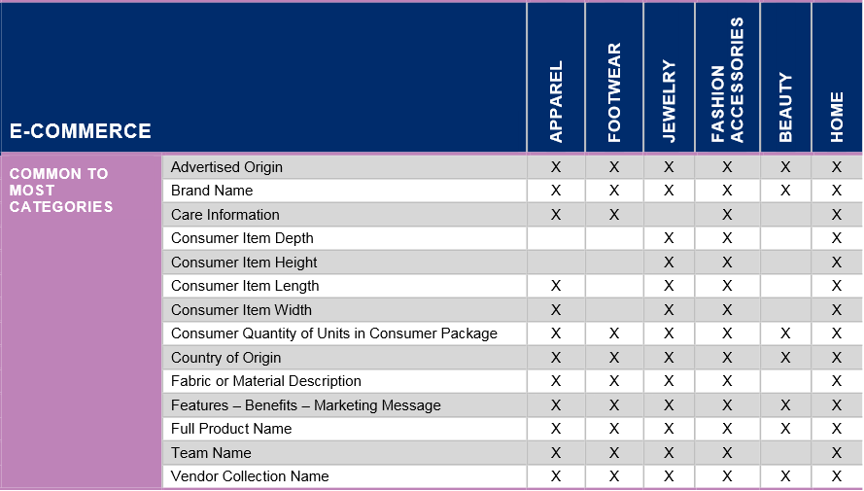
GS1 Extended Attributes
The example here is taken from the GS1 Extended Attribute Guide Release 2
Released May 2015
    Added additional attributes
    Added code lists
Current Guideline is available on the GXS landing page:
  www.gxs.com/belk
  The example here is taken from the GS1 Extended Attribute Guideline R2.0
Attributes that do not apply to a item, will not need populated:
  Example #1 = Fur Animal Name- if fur isn’t present on item, do not populate.
  Example #2 = Heel Height- doesn’t apply to shoes, no need to populate.

Slide 18

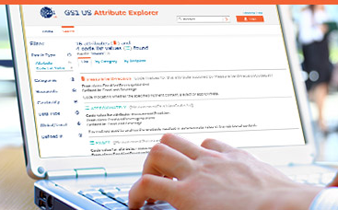
A tool for end users
  Visit the Attribute Explorer webpage at www.gs1us.org/AttributeExplorer to learn more and launch the tool
Finds information about product data attributes
Includes attributes defined by:
  GS1 US Industry Initiatives
  Regulatory mandates
Intuitive, browser-based user interface lets users:
  See a list of defined attributes
  Search attributes by name or description
  Find out what attributes are defined in what standards and guidelines
  Identify the attributes defined or required for a given product category

Slide 19
.
How Vendors Use the Catalogue

Slide 20
OpenText/GXS Active Catalogue
What is the Active Catalogue:
Retail industry’s leading product data synchronization application
Allowing marketers, manufacturers and suppliers to share their latest product information such as price, style, color, size and more than 600 additional product attributes with retailers.
Provides extensive data validations and comprehensive data attribute support. GXS Catalogue enables better management of new item introductions and item maintenance processes
Key Statistics:
Over 150 million items stored
Over 600 attributes
Over 6,000 suppliers/manufacturers/distributors
Over 200 retail hubs

Slide 21
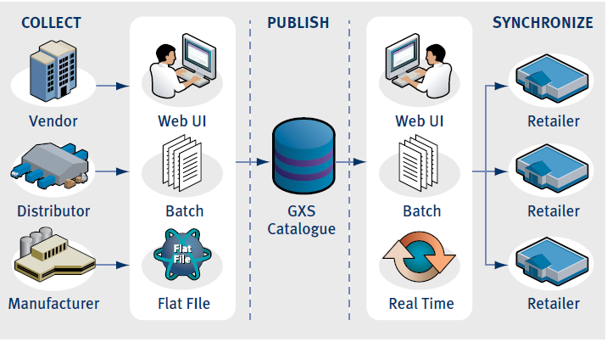
OpenText/GXS Active Catalogue
OpenText/GXS Active Catalogue enables item synchronization for all of your trading partners through a single source

Slide 22
Preparing to Load Attributes
Understand the required attributes
    Review Belk’s and OpenText/ GXS extended attribute information
    Review online resources (Belk’s Landing Page or online OpenText GXS Active Catalogue documentation) to identify what attributes you should be providing
  Publish your data using the GS1 industry standard/Catalogue attribute format
    Guides and Templates available at http://www.gxs.com/Belk
    Update your processes to support the required attributes (EDI maps, User Interfaces, etc.)
    Guides and Templates available at www.gxs.com/Belk or http://www.gxs.com/catalogue_extended_attributes

Slide 23
How Vendors Use the GXS Catalogue
Vendors can access their catalogues in a number of ways
    832
    CSV
    Web User Interface (UI)
    Web Services
No method is mutually exclusive. Most vendors use a combination of methods to publish and update their item information.
If using GXS to host images you must use
    Web Services
    User Interface (UI)
EDI 832 does not support loading physical images
    Supports the Image URL and image information

Slide 24
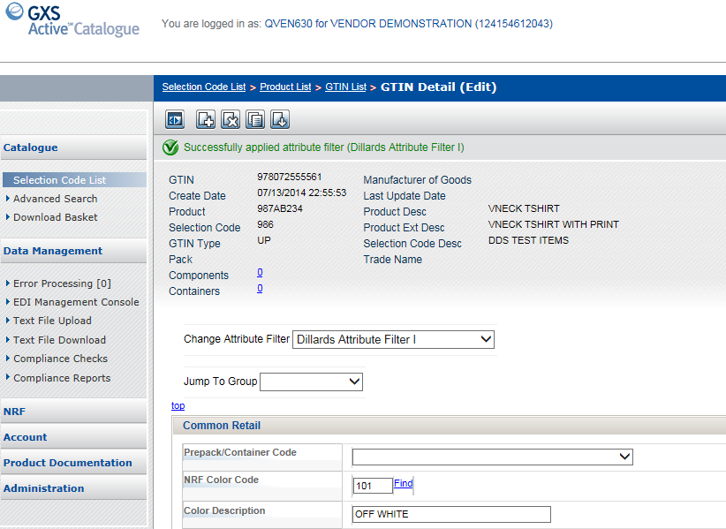
Uploading Attributes via the Web
Change filter to desired Trading Partner

Slide 25
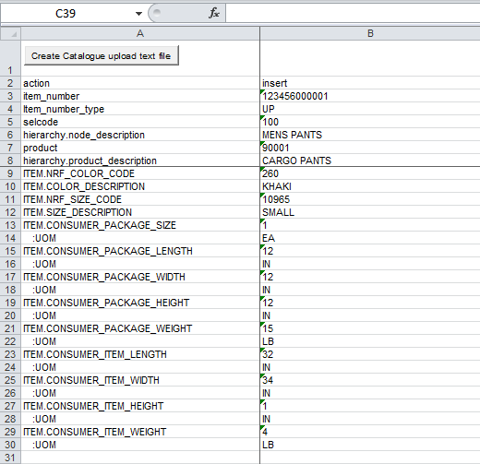
Uploading Attributes via a CSV File
Download the CSV template from the Trading Partner landing page www.gxs.com/Belk
  OpenText GXS Active Catalogue Extended Attribute Template
Fill out the CSV template offline with all of the required information.
Once complete, convert the file to a text file, and save to a location on your computer.

Slide 26
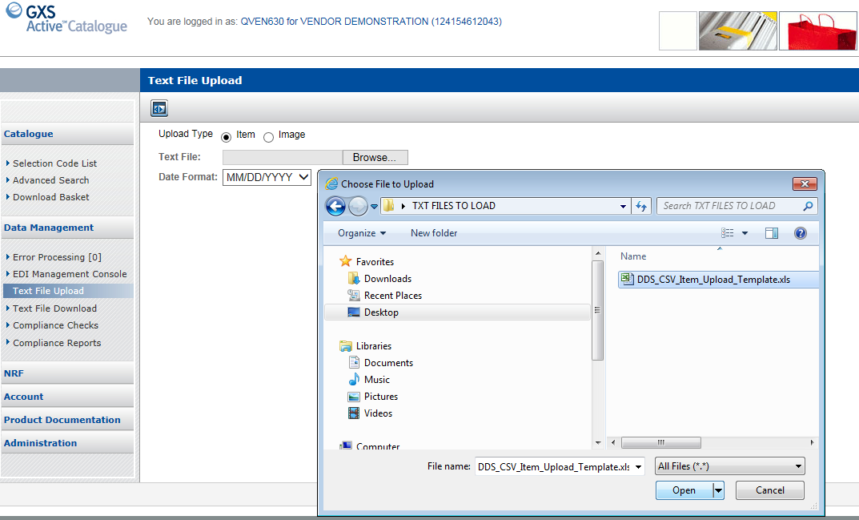
Uploading Attributes via a CSV File
Select “Text File Upload” option to retrieve you file to load to the Catalogue.

Slide 27

Uploading Attributes via an 832
If you are currently updating your Catalogue with the 832, you can reference the batch guide when adding additional attributes to your map
This is available to download on the OpenText GXS Active Catalogue website, as well as the Extended Attribute Guideline

Slide 28
.
Belk’s Requirements & Call Outs

Slide 29

Image and Content Requirements
Populate all relevant product attribute information in GXS following the GS1 ‘Voluntary Guidelines for Exchanging Extended Attributes for Ecommerce’
Provide product images in accordance with the GS1 Guidelines
Ensure all items are set up in GXS with appropriate attributes populated 8 weeks prior to ship date
Although Belk will require extended attributes in early 2016, we encourage you to begin populating extended attributes in GXS sooner
We will be conducting educational webinars to address any questions; they are currently scheduled for Dec 14-18 and Jan 11-15

Slide 30
Image and Attribute Updates
Preferred Update Method:
Populate product attribute information & product images in GXS in accordance with the GS1 guidelines
Ensure all attributes and images are in GXS 8 weeks prior to ship date
Appoint a representative from your company to be a designated Belk contact
Begin following these standards now; required in January 2016

Slide 31
Image and Attribute Updates
Alternate Update Method:
Belk is working on a project to transition to a new digital content system tied into our Master Data Management (MDM) System
This new system will replace the current vendor portal used for providing digital content to Belk and is targeted for deployment on January 22, 2016
Image Initiative – Coming in Spring 2016

Slide 32
Image & Sample Standards
Images: (Preferred Method)
Images are preferred & must be provided 8 weeks prior to ship date
Images are needed for every style number that is purchased for Belk
Images should follow the GS1 standards
Quick reference guide to the GS1 standards is available on the GXS Belk landing page and Belk.com
Samples:
Must be provided 8 weeks prior to ship date to Digital Content Team contact
Samples are needed for every style number & color code ordered for Belk.com
Samples must be given in the appropriate model size

Slide 33
.
Belk Specific Catalogue Requirements

Slide 34
Item Requirements - General
Items and packs must be set up in Open Text / GXS a minimum of 2weeks prior to the creation of Bulk Orders
Pre Packs must be set up in Open text/GXS at time of item creation
After U.P.C. size criteria has been confirmed by Belk, the setup cannot be changed; for example, S/M/L cannot be changed to 5/7/9
Vendor U.P.C. changes must be reported to Belk via email to Merch_support@Belk.com at least 60 days before implementation.

Slide 35
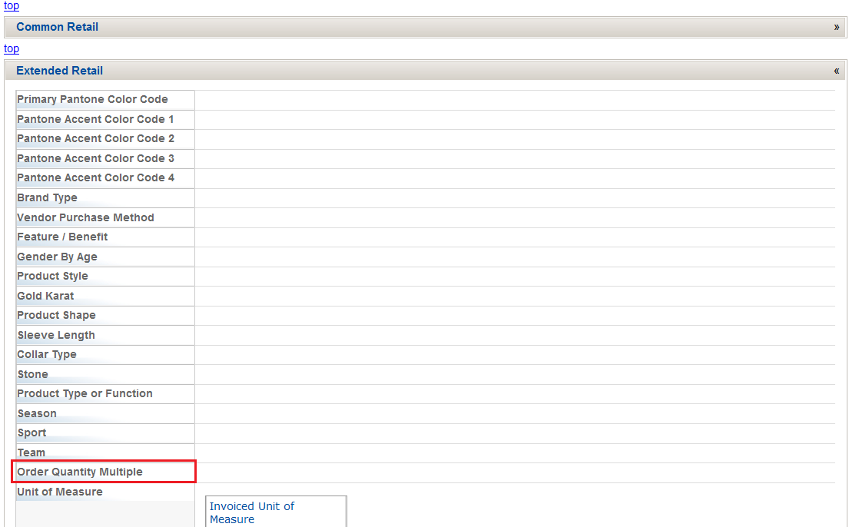
Item Requirements – UPC Usage
Reuse of U.P.C.’s must be per GS1 standards of 30 months after the last shipment by the vendor otherwise reuse may result in expense offsets and/or merchandise being rejected
Order QTY Multiple- If SKUs must be ordered in multiples other than ‘one’, this field must be populated in Open Text/GXS
35

Slide 36
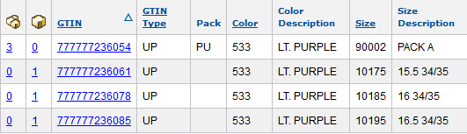
Item Requirements – NRF Codes
Items must be set up in catalog using the following:
  Correct NRF 5 digit size codes that apply to the sizing for the item using correct NRF size chart for the product you are selling. Make sure to look at both the primary and secondary description to ensure you are using the correct code
  Correct NRF 3 digit color codes that apply to color family for the item
Correct use of Pre-pack Color and Size Codes
36

Slide 37
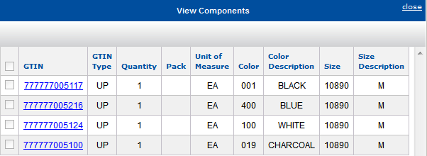
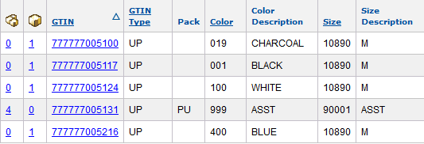
Item Requirements – Prepack / EA
If the item is a pre-pack, the following requirements apply:
  Must use the PU pack type for pre-packs and corresponding component’s must be identified & linked to the pack during initial set up in GXS Catalogue
  If configuration of the pack changes a new UPC must be provided
  Must use 90000-99999 size chart only for Pack Items

Slide 38
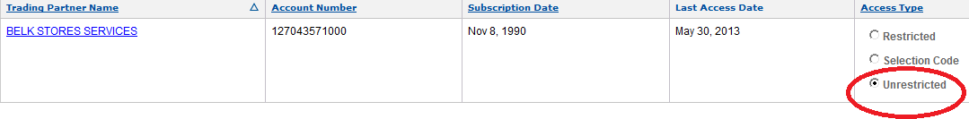
Granting Access to Belk
Belk is asking that “Unrestricted” access be granted and GMA Compliance Checks turned ‘ON’. This request is to prevent incomplete UPC data from flowing to Belk and causing downstream issues
  Belk Catalogue Account ID = 127043571000
  A step by step document on how to grant access can be found in the ‘Product Documentation’ section of the Catalogue User Interface or contact GXS directly.

Slide 39
Online Informational Resources
Topic | Comments | Link
OPEN TEXT/GXS Catalog | Belk Landing Page /Active Webinar | http://www.GXS.com/belk http://www.gxs.com/assets/uploads/wmv/livemeeting.wmv
 | Active Catalogue Information Page | http://www.GXS.com/products/active_applications/data_synchronization/OPEN TEXT/GXS_catalogue
 | Catalogue Log-In Page | https://catalogue.GXS.com/QRSGUI/jsf/login/login.jspx
Important dates
Action | Date
Hold Belk & GXS Vendor sessions at RVCF Conference | 11/8/15 - 11/11/15
Vendors required to populate extended attributes | 1/1/2016
Hold Belk & GXS Vendor sessions at RVCF Conference | 11/8/15 - 11/11/15
Monitor vendor attribute population in GXS and following up with vendors with missing attributes | January 2016 - June 2016

Slide 40

.
Meet with Belk
RVCF Annual Fall Conference
November 8-11
Scottsdale, AZ

Slide 41

Q & A Session
OpenText Active Catalogue Support:
1-800-334-2255 Options 2,5,2
or
Email Catalog Customer Support: cataloguesupport@opentext.com
Belk’s Extended Attribute Letter
  http://www.gxs.com/belk
OpenText/GXS Informational Landing Page for Belk:
  http://www.gxs.com/belk
OpenText/GXS Extended Attribute and Image informational page
  http://www.gxs.com/catalogue_extended_attributes
OpenText/GXS Active Catalogue Documentation
  https://catalogue.gxs.com/QRSGUI/jsf/login/login.jspx
* Updated documentation under ‘Product Documentation” in GXS Catalogue UI
  * FAQ can be found at http://www.gxs.com/Belk
OpenText/GXS Contacts:
Jake Divjak– Customer Manager
jdivjak@opentext.com
Don Wiener – Director Retail Accounts
Dwiener@opentext.com
Belk’s attribute and image requirements:
Digital_content@belk.com

