Slide 1
Enabling the Digital World
Adam Howatson, CMO
June 2, 2015
Notes:
SPEAKER NOTES
This presentation provides an overview of OpenText, OpenText value proposition to customers, and a high level overview of the products that OpenText provides.
The presentation is created, edited and owned by OpenText Product Marketing

Slide 2

Who is OpenText?
NASDAQ: OTEX, TSX: OTC
$1.6B
Global Revenue
100M
Users
16B
Transactions Managed
Annually
120
Global Offices
600K
Trading Partners
100K
Customers
8500
Employees
37
Data Centers
OpenText is one of the most successful software companies in the world. We’re a leader in Enterprise Information Management, helping companies manage information for improved productivity, competitiveness and customer experiences
2
OpenText Confidential. ©2015 All Rights Reserved.
2
Notes:
SPEAKER NOTES
OpenText is one of the most successful software companies in the world. We’re a leader in Enterprise Information Management, helping companies manage information for improved productivity, competitiveness and customer experiences

Slide 3

90
%
of the
Fortune 500
Companies are leveraging EIM from OpenText to turn vision into reality
3
OpenText Confidential. ©2015 All Rights Reserved.
3
Notes:
SPEAKER NOTES
For over two decades, OpenText has been a core contributor to the most successful businesses in the world

Slide 4


























































































Worldwide Customers
Notes:
SPEAKER NOTES
We are very proud of what our customers achieve with our software – across multiple geographies and in every industry.
(let me hi-light one or two specific use cases that might be relevant to you..)

Slide 5





































Worldwide Leadership
6 of the largest 10 Governments
32 of the top 50 Energy Companies
9 of the top 10 Media Companies
10 of the top 10 Pharmaceutical Companies
Customers
6 of the top 10 Legal Services Companies
14 of the top 20
Financial & Insurance
Companies
7 of the top 10 Manufacturers
9 of the top 10 Transportation Companies
Notes:
SPEAKER NOTES
Across multiple industry verticals

Slide 6





Enabling a Digital-First World
SIMPLIFY
TRANSFORM
ACCELERATE
Reduce costs, improve efficiencies and increase competitiveness
Consolidate and upgrade information and process platforms
Increase the speed of information delivery
through integrated
systems
“Digital leaders outperform their peers in every industry.”
Notes:
SPEAKER NOTES
To enable a digital-first world in this age of disruption, OpenText proposes that IT leaders place priority on these three guiding principles:
Simplify – reduce the costs and complexities of work.
Transform – consolidate systems, platforms and processes, and
Accelerate – introduce efficiencies that capitalize and monetize information

Slide 7






Digital Transformation Drivers
New Technologies
The Digital
Customer
Security &
Governance
Regulatory
Pressure
Changing Workforce
Several important factors are converging, driving the need for transformation of businesses into digital businesses.
7
OpenText Confidential. ©2015 All Rights Reserved.
7
Notes:
SPEAKER NOTES
We are living in a time when technology is causing massive disruption and change. The rate of change is unprecedented and represents both a challenge and an opportunity for organizations to reshape the way they work with information

Slide 8
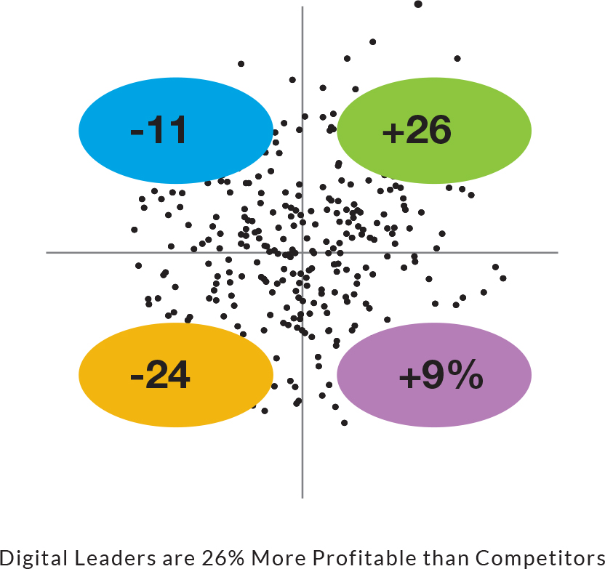





Digital Leaders are more Profitable
Digital Intensity
Transformation Management Intensity
Digital leaders are 26% more profitable than their competitors*
*Gapgemini Consulting and the MIT Center for Digital Business, “The Digital Advantage: How digital leaders outperform their peers in every industry, 2012

Slide 9






It Has Never Been So Disruptive
Cloud
Big Data
Mobile
SaaS has become the preferred way of consuming software for enterprises
Many traditional ISVs are transitioning their model to SaaS (e.g., Adobe, Autodesk, Aspentech)
SaaS continues to be near the top of acquirers’ wish lists
$32B of software, services and infrastructure to be spent on big data by 2017
Information management and analytics software expected to see most growth
Hadoop beginning to garner mainstream
adoption
Device landscape is more complicated than ever before
Multiple operating systems in use and BYOD disrupting traditional IT
Customers expect information and
services to be available on any device,
at their time of need
Security
Digital
Internet of Things
Governance, Risk & Compliance to become a $10B market by 2018
The threat landscape is evolving as perpetrators are less known, attacks are more often multi-stage, hard to discover, and highly targeted
Large enterprises such as Thomson
Reuters, IBM, Oracle have entered
space through M&A as they see potential
opportunity
From Big Data to Cloud Computing, more than half of executives (52%) see digital technologies significantly transforming their industry
Digital disruption is accelerating business processes, for a fraction of the cost, drawing from a larger, more social network of ideas
Social technologies continue to push
further into the enterprises as more and
more use cases are being discovered
$8.9 Trillion in IoT related revenue expected by 2020 across verticals
Highly strategic opportunity that is getting interest from many large IT enterprises
Digital home, telematics, connected car
all early-stage, tangible examples of IoT
Source: IDC, Gartner

Slide 10




Amount of Data is Exploding in all Sectors
90% of world’s data generated
over the last 2 years
My Average Information Day
500 Emails
5 Faxes
100 Documents
50 Images
40 Social Interactions
10 Contracts
10 Videos
An average 700 objects per day @ 350 days work per year = 250,000
@ 8,000 employees =
1.9 Billion
objects
Mobile data traffic will grow 13X
by 2017
every
More information created
than from 0 AD-2003
2
days
15 of 17 U.S. sectors
have more data per company than Library of Congress
20,000 TB processed
every day
1M transactions
every hour
144,000 hours of video uploaded
every day
2.5M shared pieces of content
every minute
Notes:
90% of data is not leveraged in any way
Data-driven decision making associated with 5-6% higher productivity. Source Erik Brynjolfsson, Lorin Hitt, and Heekyung Kim, MIT

Slide 11















Simplify
Reduce the complexity of our working lives
Minimize the human errors in routine business tasks
Make information more easily accessible for a wider audience
Notes:
SPEAKER NOTES
Over the past several years we have heard hundreds of managers talk about the negative impact of complexity on both productivity and workplace morale.
An easy starting point for simplification is to get rid of any unnecessary steps in low-value activities; for example, look at how many people are needed to review and sign off on expense reports or approve small purchases; or how many times slide decks need to be reviewed before they are presented. Figure out what’s really important (and what’s not), and continually reassess the priority list as new things are added.
Compared to a customized software solution, an integrated suite will likely lower a business owners’ dependence on IT. A cloud offering can often be deployed faster than on premise, but may lack the required flexibility and security for enterprise business needs; whereas a hybrid cloud implementation might provide the best of both worlds. Keeping an open mind to different modes of deployment and limiting customizations can make for an easier/simpler life.
Human errors are significant factors in almost every business process – IT leaders should look to implement systems that reduce the frequency of human errors. Ask yourself, Is it possible to leverage data in one system to enrich a process in another? Can a scanned form be transformed automatically into digital data? Can analytic data be used to guide decision making to improve productivity?

Slide 12
The Nexus of Forces in a
Digital-First World
Changing Workforce
Several important factors are at work, driving the transformation of businesses into digital businesses.
Security &
Governance
Regulatory
Pressure
New Technologies
The Digital
Customer
Notes:
SPEAKER NOTES
We are living in a time when technology is causing massive disruption and change. The rate of change is unprecedented and represents both a challenge and an opportunity for organizations to reshape the way they work with information

Slide 13

New Technology
By providing direct,
unrestricted access to information, new digital
technologies empower
workers in ways not
previously possible.
PC
Notes:
SPEAKER NOTES
New technologies, such as wearable devices, 5G networking and 3D Printing, are empowering workers, providing them with instant access to ever increasing volumes of information.
Your challenge, as an senior IT executive, is to provide your workers with the ‘context’ that enables that the new technology to improve the way they do their work.

Slide 14


Slide 15
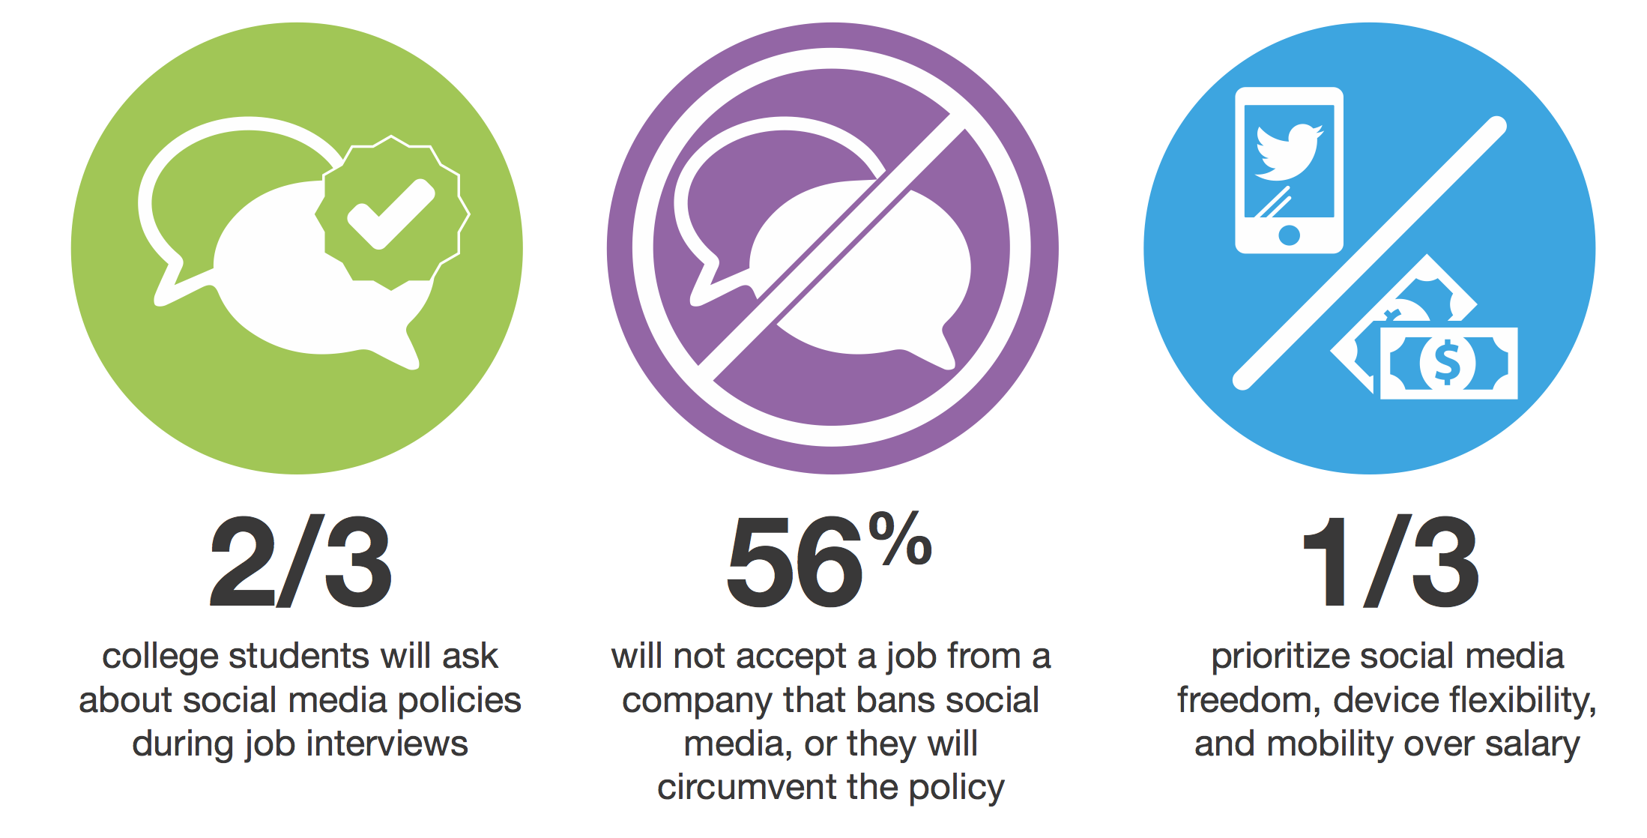
Changing Workforce
A new youthful workforce will overturn many traditional attitudes about workers, working, and the workplace.
Notes:
SPEAKER NOTES
The workforce is rapidly evolving. Today, more and more of your employees were born in the ‘age of the internet’. They ‘expect’ to be socially interactive with their co-workers and to have mobile access to business information – ‘social’ and ‘mobile’ are therefore no longer objectives for competitive advantage, they are critical requirements for survival in the digital-first world.

Slide 16





Governance and Security
Cyber-related activities will become more sophisticated and even more disruptive.
2012
2014
2015
Java Vulnerability
Was exploited
1 month after
it was discovered
Heartbleed Virus
Was exploited
2 days after
advisory issued
Unknown Threat
Might be exploited only hours after being planted
Notes:
SPEAKER NOTES
The increased freedom with which we access information, is coupled with a rising vulnerability to cyber-crime. The intent of perpetrators is no longer just to disrupt business activity but a to steal information and to exploit it for financial gain.
Business leaders expect IT to protect workers and keep corporate information safe, while at the same time, demanding instant availability and transparency!

Slide 17
Regulatory Pressure
In every industry, organizations will be under increasing levels of scrutiny and global regulatory pressure.
Canadian Electronic
Evidence Act
SEC 17a-4
DoD
Basel II
Capital Accord
Electronic Ledger
Storage Law
HIPAA
11 MEDIS-DC
ISO/PRFTR15081
AIPA
FDA 21 CRF Part 11
GDPdU & GoBS
& DOMEA
Sarbanes-Oxley Act
NF Z 42-013
Federal Rules of
Civil Procedure
Financial Services Authority
VERS
MoReq 2010
BSI PD5000
Notes:
SPEAKER NOTES
Transparency is required not just for better customer and investor relations but also for regulatory compliance. In every industry, organizations are under increasing levels of scrutiny and global regulatory pressure.

Slide 18

Digital Customer
Most buying decisions will be made before contacting vendor and most purchases will be done online.
Marketing has to be relevant - utilize location, situation, and presence.
Notes:
SPEAKER NOTES
The way we interact with customers has also been heavily influenced by digital transformation and innovation.
Whether selling to consumers or to businesses, your customers are making buying decisions before they ever engage with your sales force. Customers are conducting more and more purchases online across more and more sectors. By the year 2020, we will be buying goods online that are today considered impractical to sell via the web, such as perishables, cars, and real estate. Marketing needs to increasingly focus on personalized, relevant, and engaging content – because everything else will be either noise or illegal.

Slide 19













Transform
Re-Think
Re-Build
Re-Design
Re-Platform

Slide 20


37 Core Data Centers
800 Customers Hosted
100 Registered Copyrights
33 Satellite POPs
2B Faxes
14 Technical & Process Patents
60,000 Customers
40+ Data Center Regional Standards
43M Transactions / Day
$6.5 Trillion in Transactions/year
3.5 PB Content Stored
80+ Industry & Technical Standards

Slide 21



It’s a Hybrid World
Some information and applications belong on premises
Gartner says over half of enterprises will use some combination of public and private cloud by 2017.
Its about balance and control, data sovereignty and compliance.

Slide 22



OpenText Key Markets
Information Management
Compliance
B2B Commerce
Process
Applications
Platforms
Information Governance
Risk Management
Process Control
Business Network
Trading Partners
Vertical Solutions
Deployment
Services | On-Premises | Managed Services | PaaS | SaaS
Notes:
SPEAKER NOTES

Slide 23





Enterprise Information Management
Discovery
Business
Process
Management
Enterprise
Content
Management
Customer Experience
Management
Information Exchange
Discovery
Suite
Process
Suite
Content
Suite
Experience
Suite
IX
Suite
5 Technology Pillars / 5 Product Suites
Notes:
SPEAKER NOTES
The core capabilities: Manage content, and make it available without compromising security and governance. Create and continually improve business processes. Create rich, engaging experiences for customers, markets, employees and partners. Exchange information. Discover information. Provide platforms and enable application development. Help customers extract more value out of their existing investments, particularly investments into the largest enterprise SW companies. Finally, provide solutions in the cloud and on premises.

Slide 24


Flexible Deployment Options
On Premises
Hybrid
Cloud
Notes:
SPEAKER NOTES

Slide 25







Legal
Contract Management
Information Governance
Case Management
Procurement &
Supply Chain
Supply Chain Visibility
Procure to Pay
Vendor Invoice Management
SOLUTIONS
Marketing
Brand Management
Omni-Channel eCommerce
Customer Correspondence
Operations
Capital Projects
B2B Outsourcing
Asset Management
Finance
Electronic Invoicing & Payments
Bill Presentment
Travel Receipt Management
Risk & Compliance
Policy Management
Corporate Social Responsibility
Regulatory Records Retention

Slide 26












Policy Management
Supply Chain Risk Management
Conflict Minerals Reporting
Know Your Customer
Protection of Personal Information
Compliant Records Disposition
Contract Management
Asset Management
Capital Projects
Vendor Invoice Management
Electronic Invoicing & Payments
B2B Outsourcing
Procure to Pay/Order to Cash
Contract Management
Asset Management
Capital Projects
Vendor Invoice Management
Electronic Invoicing & Payments
B2B Outsourcing
Procure to Pay/Order to Cash
Contract Management
Case Management
Asset Management
Capital Projects
Vendor Invoice Management
Case Management
Customer Facing Apps
Customer Correspondence
Supply Chain Visibility
Operational Intelligence
Policy Management
B2B Outsourcing
Procure to Pay/Order to Cash
Compliance
Support
Finance
Facilities
Logistics
Procurement
Marketing
Operations
SOLUTIONS
IT
Legal
Omni-Channel eCommerce
Brand Management
Digital Media Supply Chain
Customer Facing Apps
Bill Presentment
Customer Correspondence
Media Library
Product Catalogue
Contract Management
Information Governance
Business Performance (BI)
Regulated Documents
Transmittals
Asset Management
Capital Projects
Supply Chain Visibility
Operational Intelligence
Policy Management
HR
Production
Informational Governance
Omni-Channel eCommerce
Virtual Desktop Infrastructure
Business Performance (BI)
Embedded Reporting
Policy Management
Contract Management
Information Governance
Case Management
Related Documents
Early Case Assessment
Policy Management
Contract Management
Case Management
Talent Management
Employee File Management
Policy Management
Digital Media Supply Chain
Virtual Desktop Infrastructure
Regulated Documents
Engineering Document Mgmt

Slide 27





Energy
License to Operate
Enterprise Asset Management Governance
Engineering and Capital Projects
Asset Information Management
Manufacturing
Conflict Mineral Reporting
Product Design Information Management
Supply Chain Enablement
Plant Maintenance/Factory Asset Management
Dealer Information Exchange
VERTICAL
SOLUTIONS
Media & Entertainment
Media Operations
Digital Media Supply Chain
Media Commerce
Life Sciences
Part 11 Regulated Information Management
Collaborative Trial Management
Electronic Submissions
Financial Services
Digital Marketing for Client Acquisition
Managed Services for Corporate Payments
Client Onboarding and Account Opening
Public Sector
Capital Projects
B2B Outsourcing
Asset Management

Slide 28





















OpenText Cloud
Managed Cloud Services
Platform
Platform
Applications
B2B Managed Services
(GXS)
Managed Private Cloud
(EIM Hosting)
PaaS-based Messaging Service
EasyLink Fax2Mail
Notifications
On Trading Grid
PaaS-based
Messaging Service
GXS VAN, EDI
On Trading Grid
EIM SaaS Applications
Secure Mail
Secure MFT
Active Apps
Case Framework
870 Customers
Growth Business
20,000 Customers
2B Faxes/Year
40,000 Customers
16B Transactions/Year
Emerging Business

Slide 29


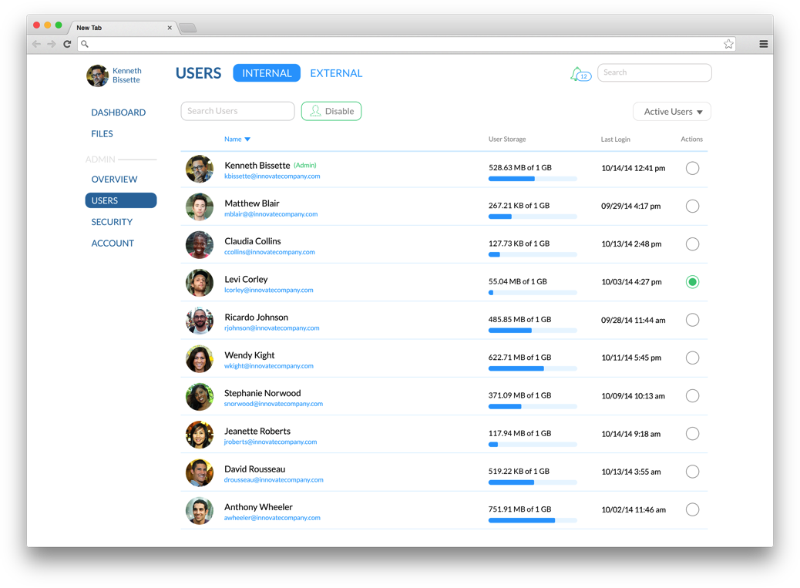
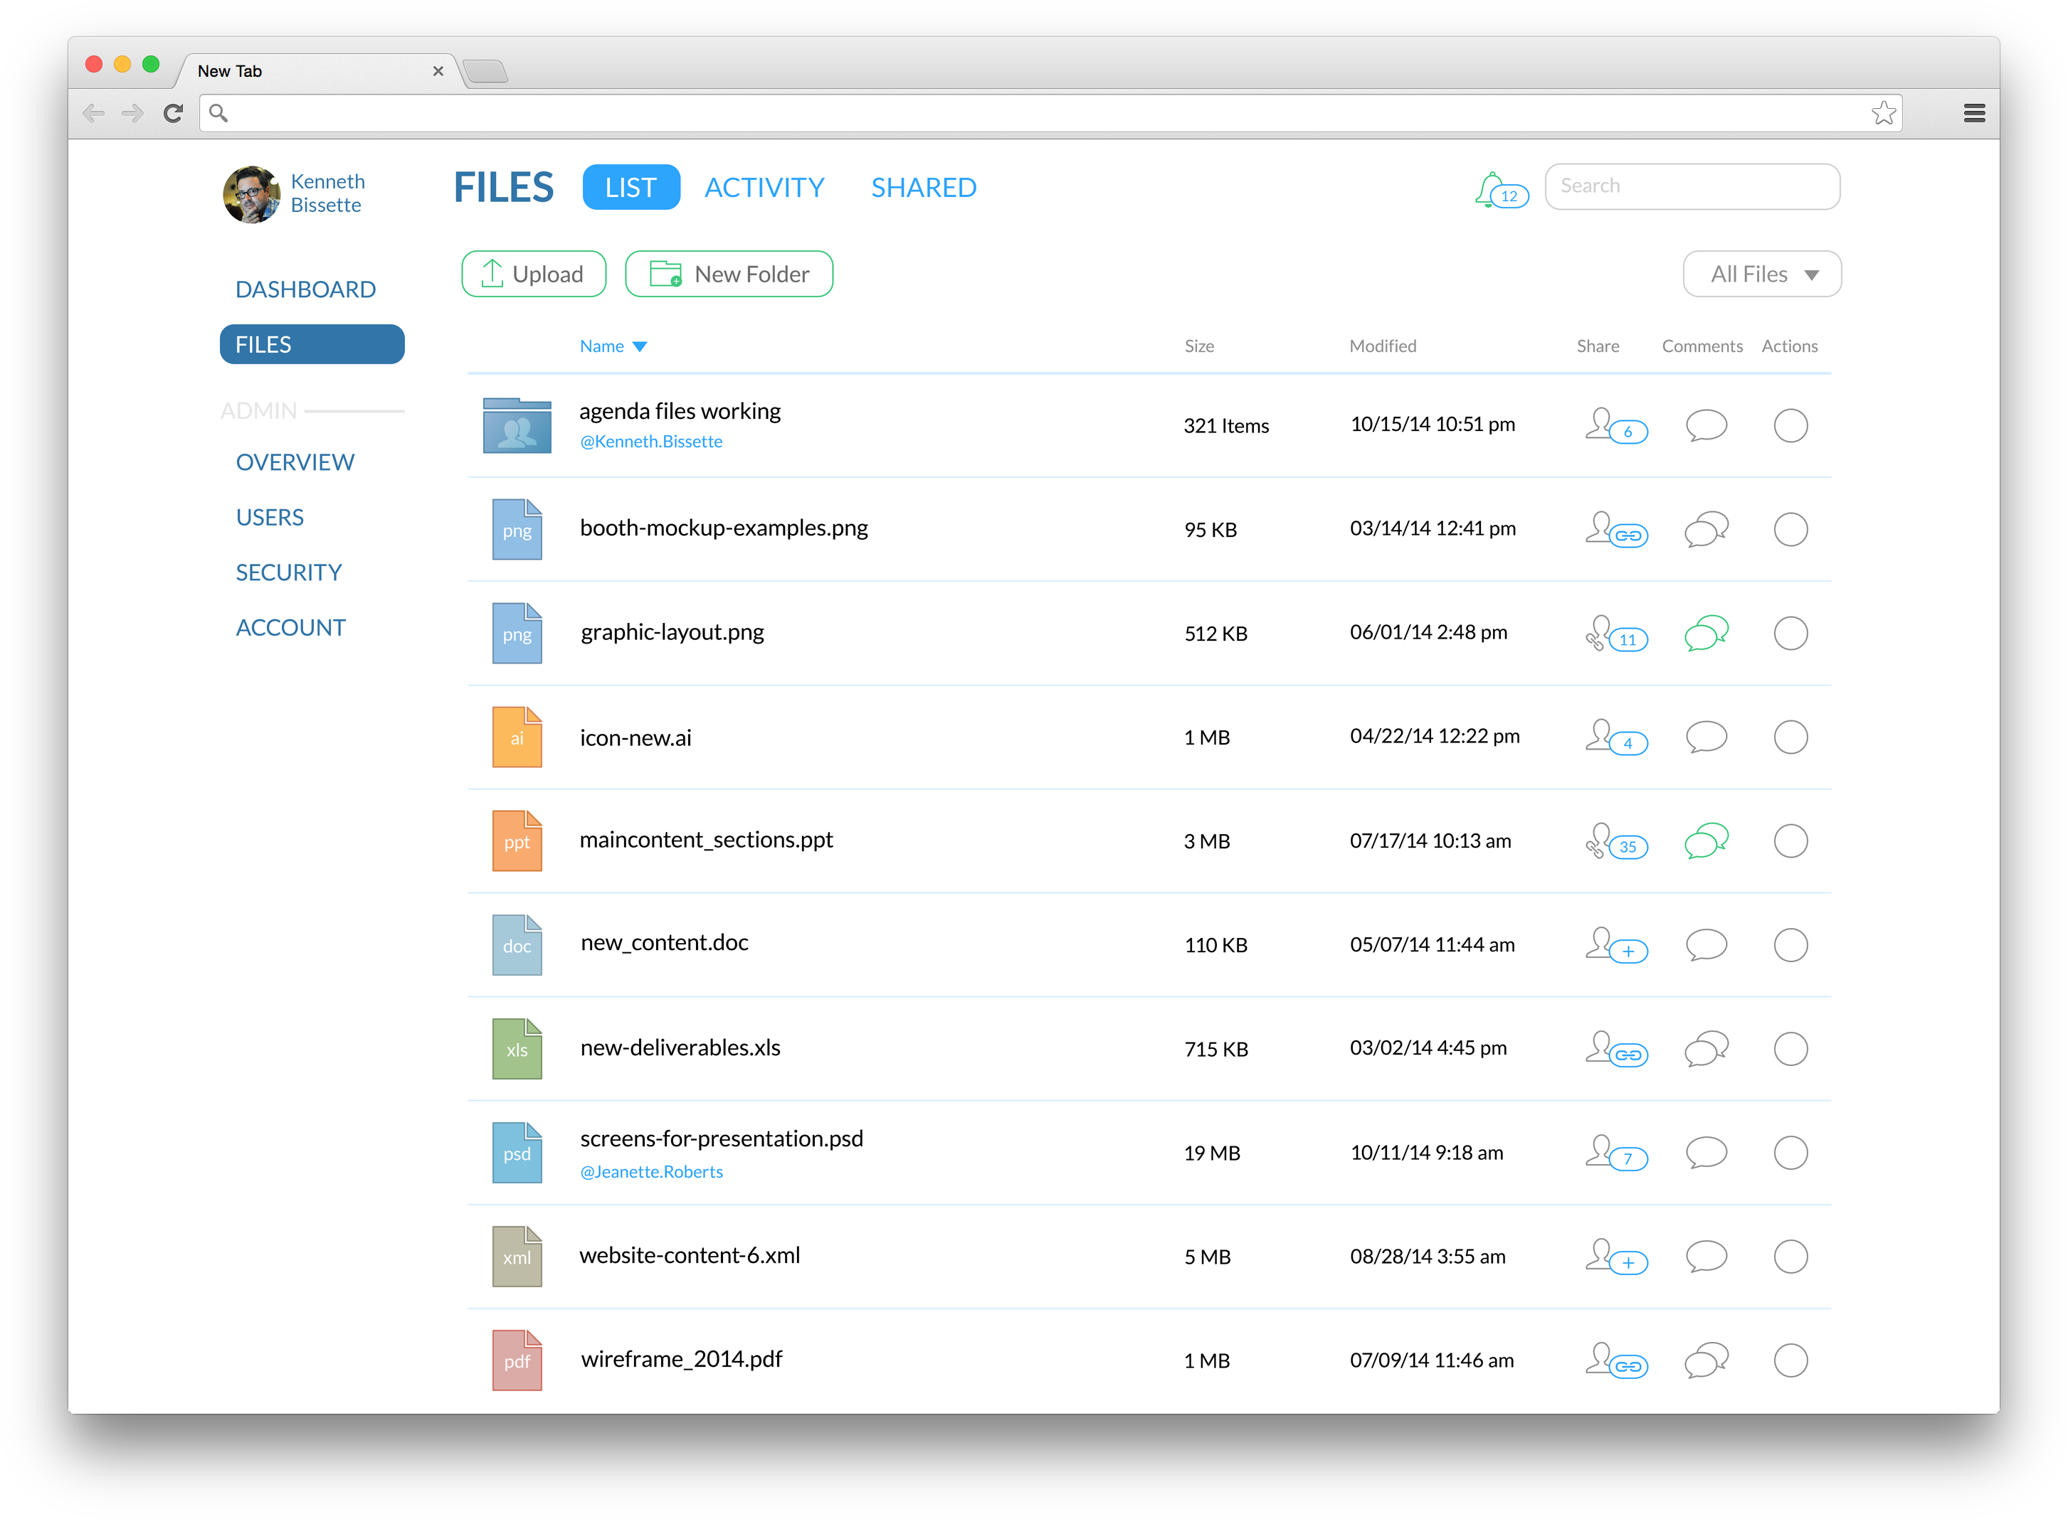

OpenText Core
Document Management
Simple UX – web, phone, tablet, desktop
Drag and drop uploads
File versioning
HTML5 file viewer
Sharing and Collaboration
Internal and external sharing
User Dashboard and activity feeds
Email and Push Notifications
Desktop Edit
Desktop editing on Mac and Windows
Administrative Controls
Admin Dashboard, user management
and reporting
Access management and remote wipe

Slide 30









OpenText Cloud Customers
Digitized $65B of commerce
Digitized global cash
Accelerating well being
Delivering on the best customer experience
Leading the way in direct payments
Simplified Global
Treasury Management
Solving the world’s greatest health challenges
Every process starts and ends with a fax
Leading the way in performance
World’s largest automaker on the world’s leading business network

Slide 31
Accelerate via Analytics
Information drives innovation and growth.
Greater insight
Higher customer satisfaction
Time to market
New opportunities, and enables you to remain competitive.
Notes:
SPEAKER NOTES
At the heart of all the new technological innovation and disruption is information. No longer is information considered just the cost of doing business – now, it is well understood that information can be instrumental in driving innovation and growth.
When used the right way, information leads to greater customer satisfaction, accelerates time to market, helps to open new opportunities and enables you to remain competitive. In short, information is a key strategy component for every organization today.

Slide 32
4 Pillars of Business Analytics
Information Management Foundation
Organization
Fact-based Decision Making Process
Appropriate Technology Platform
EIM
Data Governance
Info-Driven Enterprise
IT / Business Interactions
Information an asset
Instinct vs. analytics
Integrated toolset
Integrated delivery platform
Not silos of capability
Flexible Platform | Disparate Sources | Personalization

Slide 33


Information Enables Transformation
“Analytics represent the next frontier in a customers’ ability to derive value from their information”
Consumerization of IT
Digital Disruption
Challenges
Emerging Big Data
Notes:
SPEAKER NOTES
At the heart of all the new technological innovation and disruption is information. No longer is information considered just the cost of doing business – now, it is well understood that information can be instrumental in driving innovation and growth.
When used the right way, information leads to greater customer satisfaction, accelerates time to market, helps to open new opportunities and enables you to remain competitive. In short, information is a key strategy component for every organization today.

Slide 34
Most Critical Business Intelligence Initiatives
Providing users of all levels with relevant, actionable intelligence, within the context of the specific use case within an app
Embedded BI
Dashboards & visualization
Big Data & data warehousing
End-user “self service”
Simple, informative, and complete
Making sense of large amounts of data that was historically difficult to process as well as capture, manage, store, search, and share as required
Available now, to whoever needs it

Slide 35
Enabling a Digital-First World
SIMPLIFY
TRANSFORM
ACCELERATE
Reduce costs, improve efficiencies and increase competitiveness
Consolidate and upgrade information and process platforms
Increase the speed of information delivery
through integrated
systems
“Digital leaders outperform their peers in every industry.”
Notes:
SPEAKER NOTES
To enable a digital-first world in this age of disruption, OpenText proposes that IT leaders place priority on these three guiding principles:
Simplify – reduce the costs and complexities of work.
Transform – consolidate systems, platforms and processes, and
Accelerate – introduce efficiencies that capitalize and monetize information

Slide 36



www.opentext.com
twitter.com/opentext
facebook.com/opentext
linkedin.com/company/opentext

