Slide 1

OpenText Catalogue
Image and Attribute Best Practices

Slide 2

Agenda
Introductions
Business Drivers
Vendors Best Practices on Catalogue Usage
Providing Extended Attributes via OpenText
Providing Images via OpenText
A Vendor’s Perspective
Q & A
Appendixes
Extended Attributes and Images

Slide 3

Dillard’s
Anita Spence
Director, Vendor Relations
Rick Whitley upc.catalog@dillards.com
UPC Catalog Support Analyst
Grace Evans ebiz.support@dillards.com
Image and eBiz Support Analyst
OpenText
Don Wiener
dwiener@opentext.com
Director, Customer Relationship Management
Doug Smith
dsmith1@opentext.com
Sr. Customer Relationship Manager
Ken Terhurne
kterhurne@opentext.com
Customer Relationship Manager

Slide 4
Why Images and Attributes
Ecommerce
Buying & Planning merchants
Supply Chain
Tax
Stores
Legal
Enhance Search Engine Optimization (SEO)
Additional selling features improve sales
Customers want more information for better purchasing decisions
Automated process improves cycle time to website
Omni-channel facilitation
Brand identity
Review image at time of PO entry
Utilize attributes for enhanced reporting and allocation to stores
Hazardous materials for package handling
Dimensional/weight information for fast put away at Fulfillment Center
Image assist Fulfillment Center associates with picking & packing customer orders
Images to help with store fulfillment and promotional event set up
Attributes to support various tax rules in store and online. For example, SPF is tax exempt in Texas
Necessary for complying with US Dept. of Commerce rules, i.e., animal fur name

Slide 5
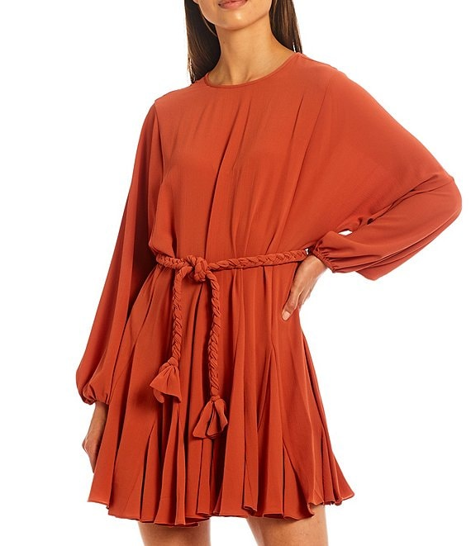
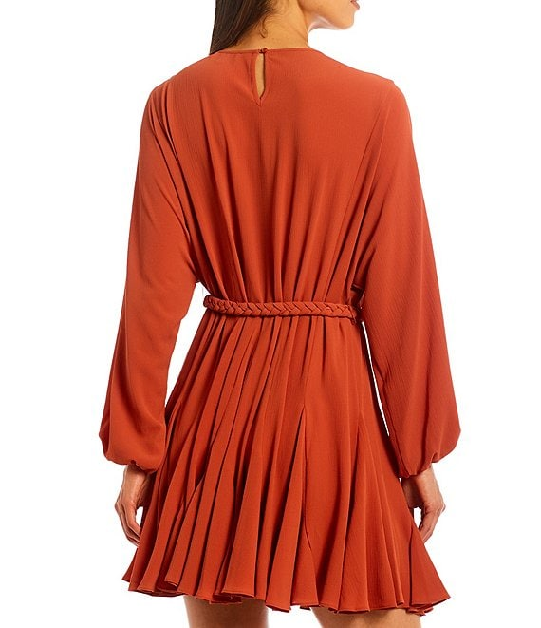
Item Set-up and E-commerce Challenge
Item Setup/Ordering
Publishing/Selling
Gianni Bini
Georgette fabrication
A-line silhouette
Round neckline
Long sleeves with elastic cuffs
Removable braided belt at waist
Ruffle hemline
Back keyhole button closure
Approx. 34.625" length
Polyester
Dry clean
Imported
12 Digit Product/Style Number
20 Digit Product Description
12 Digit Color Description
3 Digit NRF Color Code
10 Digit Size Description
5 Digit NRF Size Code
12/13 Digit UPC/EAN Number
Sleeve Type
Closure
Fabric
Country of Origin
Etc..

Slide 6

Current Business Process for Providing Images/Attributes
Line Sheets at Market Appointment
Multiple Spreadsheet Formats
Multiple Image Formats
Running Around the Building Gathering Data
Email Attachments
Snail mail
Disc

Slide 7
Manual item set-up=supply chain inefficiency
Vendor A
Large Retailer A
Distributor B
Small Shop B
Postal mail
EDI
Supplier C
Retailer
new item form
Wholesaler D
Specialty Retailer C
Telephone
Facsimile
Purchase
order
Manufacturer E
Large Retailer D
Proprietary
Spreadsheet
Vendor F
Web portal
Online Retailer E
Email
XML
Redundant expenses
Erroneous purchase orders
Chargebacks/write-offs
Incorrect invoices
Merchandise delays
Lost sales

Slide 8
Active Catalogue
Retail’s leading data synchronization solution
More than 210 million items stored
More than 700 attributes
More than 5,800 suppliers/distributors
More than 200 retail hubs
Collect
Publish
Synchronize
Vendor
Retailer
Web UI
Web UI
Distributor
Retailer
Batch
Active Catalogue
Batch
Manufacturer
Retailer
Flat file
Real time

Slide 9
Benefits in Using the OpenText Catalog
Vendor Benefits
Consistent Brand Representation
Retailer Benefits
Create a consistent Customer Experience For Omni-Channel
Eliminate Many Existing Manual Labor-Intensive Processes
Produce One Set of Images and Attributes for All Retailers
Reduce the Need to Provide Samples for Retailers to Handle Their Own Photography
Allows Product Images & Attributes to be Provided Much Earlier in the Business Process Cycle (Pre-Marketing Possible)
Consistent Format and Transport from Vendors
Eliminate Many Existing Manual Labor-Intensive Processes
Less Errors in Matching Images and Attribute to Product
Publish Product Earlier in the Process – Speed to Market!

Slide 10
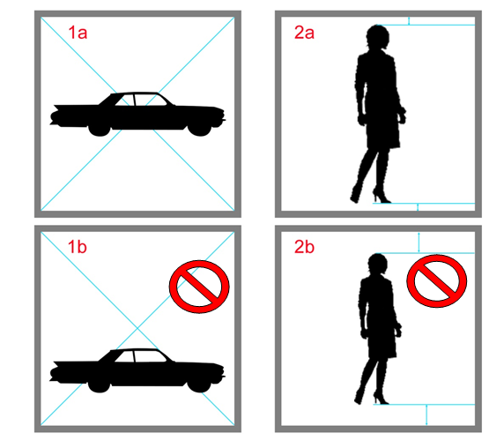
GS1 Industry Standard Guidelines for Images
Consistent Image Size and Format
File Format and Color Mode:
  JPEG - level 10 compression
  RGB – 8 bit per channel
Background
  White - (RGB 255/255/255)
Image Size
  Minimum size 2400 x 2400 pixels
  Maximum size 4800 x 4800 pixels
  300 ppi
  Centered
    5% Maximum White Space On Either End of Largest Image Axis

Slide 11
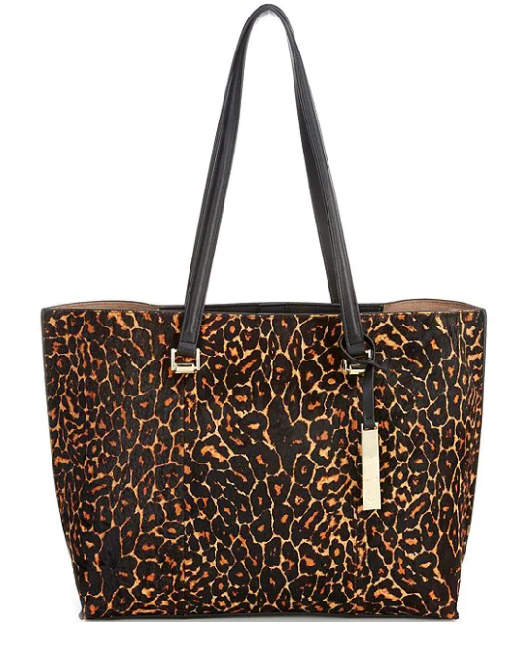

Additional Selling Features Improves Sales
  Product Imagery
    Attractive
    Accurate
    Multiple Angles
    High Resolution
    Limit Accessories
    Focus on Item Being Sold

Slide 12
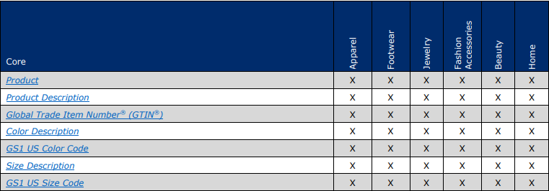
Extended Attribute Guide
Go to GS1 Website to download the latest GS1 Best Practices Guideline for Exchanging Images and Attributes
https://www.gs1us.org/industries/apparel-general-merchandise/implementation-resources/best-practice-guideline-for- exchanging-product-images-and-attributes
Locate your line of business and review the Core and Extended Attributes that apply to your products.

Slide 13
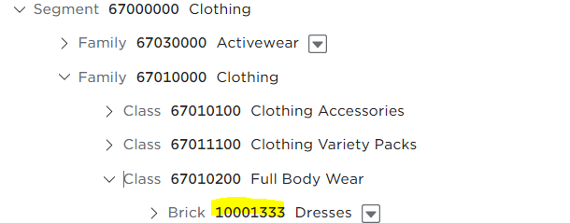
The Global Product Code (GPC) Attribute
Segment
Clothing
An industry sector
Family
Clothing
A broad division of a segment
Class
Full Body Wear
A group of similar categories
Dresses
Brick (use brick code for catalog upload -10001333)
A category of similar products

Slide 14
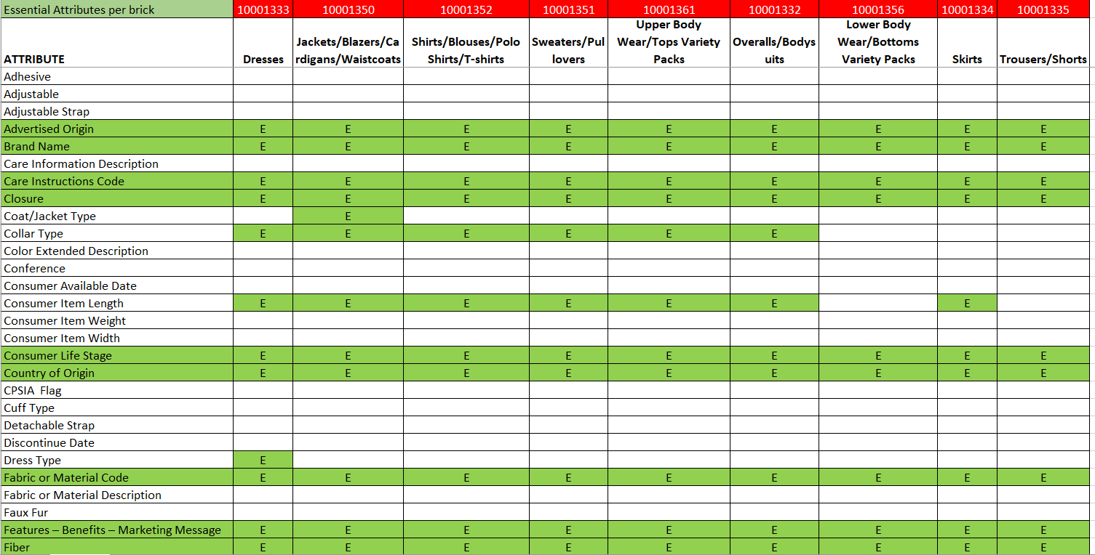
GS1 Apparel Attributes

Slide 15
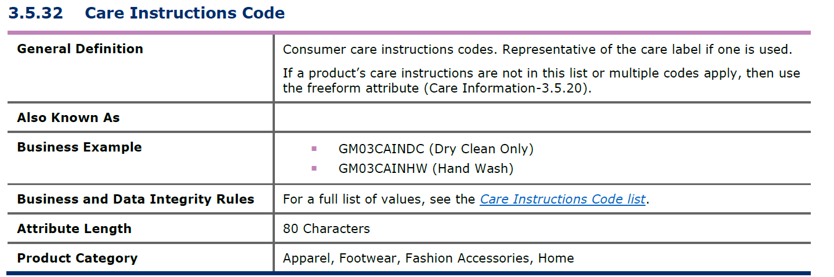
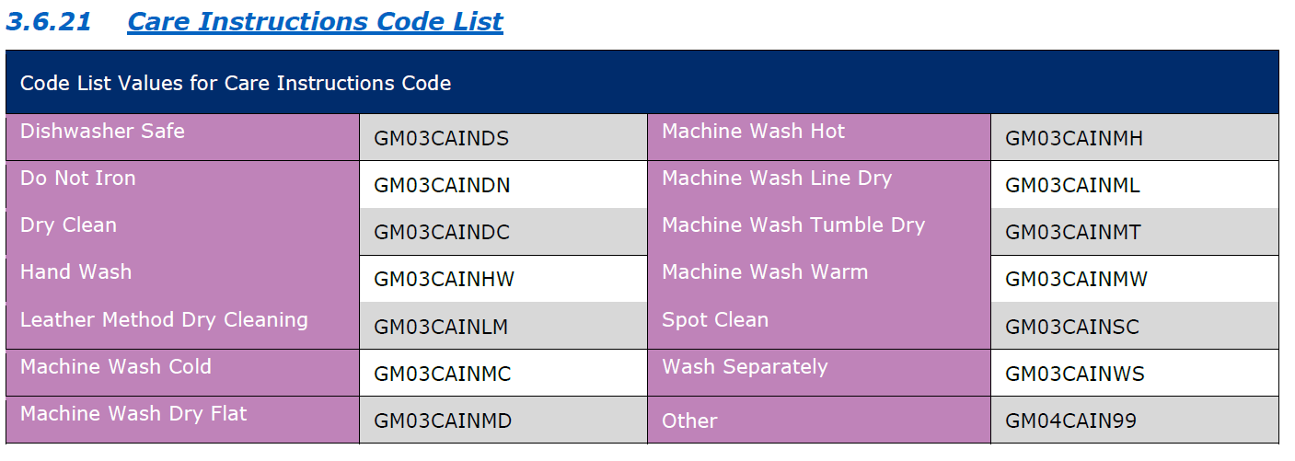
Example of Care Instructions Code Values

Slide 16
Current Image and Attribute Status
115 Vendors
  Images - In production on the Catalogue
155,000 Images Received
  85,000+ in 2021
  70,000+ in 2020
900+ Vendors
  Attributes - In production with some extended attributes

Slide 17
When Do You Load to the Catalog
GTIN/UPC – Core & Extended Product Attributes
  Load at time of market or product introduction, or within one week of market
  Load as many extended attributes as you can provide at the time of GTIN/UPC setup
Images & Marketing Attributes
  Load 8 weeks prior to items’ first ship date
  These are industry best practices & there may be exceptions for each trading relationship

Slide 18
Preparing to Load Attributes and Images
Understand the requirements
Obtain the required attributes and images
Transform your data into the industry standard/Catalogue attribute format
  Guides and Templates available at: https://www.opentext.com/products-and-solutions/products/business-network/customers/catalogue-extended-attributes
  Update your processes to support the required attributes (EDI maps, User Interfaces, etc.)
  Review Dillard’s image and attribute information, vendor communications, etc. at: https://www.opentext.com/products-and-solutions/products/business-network/customers/dillards

Slide 19
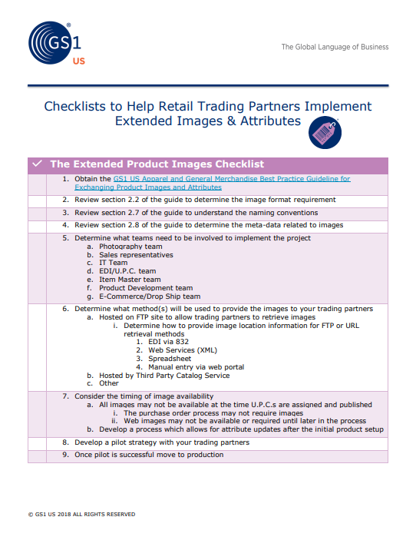
Checklist in Preparing to Load Items into OpenText
Visit the GS1 Attribute and Image website for information that can help you implement a strategy within your company.
https://www.gs1us.org/DesktopModules/Bring2mind/DMX/Download.aspx?Command=Core_Download&EntryId=435

Slide 20
How Vendors use OpenText Catalogue
Vendors can access their catalogues in a number of ways to load images and attributes
    832
    CSV
    Web User Interface (UI)
    Web Services
No method is mutually exclusive. Most vendors use a combination of methods to publish and update their item information.
  Visit: https://catalogue.gxs.com and download the proper user guide
  Should you need assistance or have questions, you can reach support at: +1 800 334 2255 option 2 or help@opentext.com

Slide 21
Uploading Images in your Catalogue
When you choose to load or update your images or image information via the Catalogue, you should first download the following guides:
  GS1 Image and Attribute Guide
    https://www.opentext.com/products-and-solutions/products/business-network/customers/catalogue-extended-attributes
  OpenText Brower Interface User Guide for Vendors
    https://catalogue.gxs.com
  OpenText Image Actions Template for Catalogue Image Data for CSV
    https://catalogue.gxs.com
  OpenText Web Service Guide
    https://catalogue.gxs.com

Slide 22
Multiple Ways to Upload Images
The Catalogue can support your physical images and/or your image information.
  The physical image can be loaded to the Catalogue by:
    Web Services
    Web User Interface
  The image URL and information can be loaded to the Catalogue by:
    Web Services
    Web User Interface
    832
    CSV File Template

Slide 23
Direct to Catalog vs URL Link
What is the difference between loading a Physical Image to the Catalog or loading an External Image URL ?
  A Physical Image is the actual image of the product loaded to OpenText
    Directs Retailers to the OpenText Catalogue to pull images
  The Image URL is the external location of where the image is hosted
    Your FTP, Dropbox or URL location
    Image Name
    Facing
    Directs the Retailer to your hosting site to pull images

Slide 24

Case Study
To see how another company has implemented the use of images, J.Renee and GS1 authored a white paper that is very informative.
https://www.gs1us.org/DesktopModules/Bring2mind/DMX/Download.aspx?Command=Core_Download&EntryId=368

Slide 25
Questions/Appendixes

Slide 26
Appendixes
Useful Links
Extended Attributes
  Screenshots/Examples/Information
Images and Image Information
  Screenshots/Examples/Information

Slide 27
Useful Links
OpenText Extended Attributes and Images
  https://www.opentext.com/products-and-solutions/products/business-network/customers/catalogue-extended-attributes
OpenText Catalogue
  https://catalogue.gxs.com
GS1 Apparel & General Merchandise Page
  http://www.gs1us.org/industries/apparel-general-merchandise
OpenText Support
  help@opentext.com or +1 800 334 2255 option 2

Slide 28
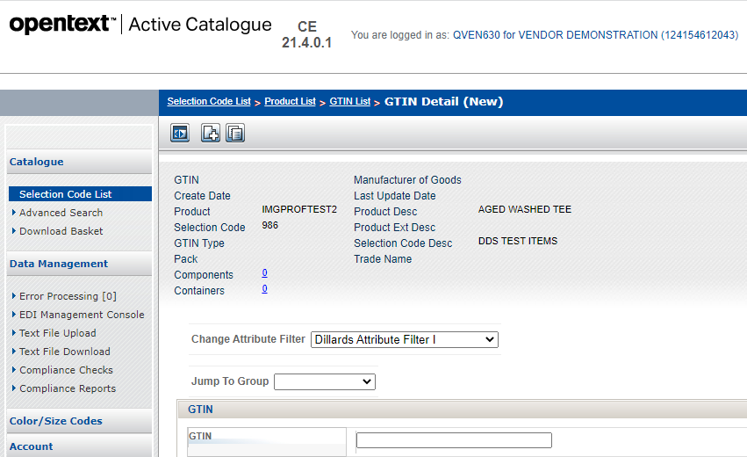
Uploading Attributes via the Web
Change filter to desired Trading Partner.

Slide 29
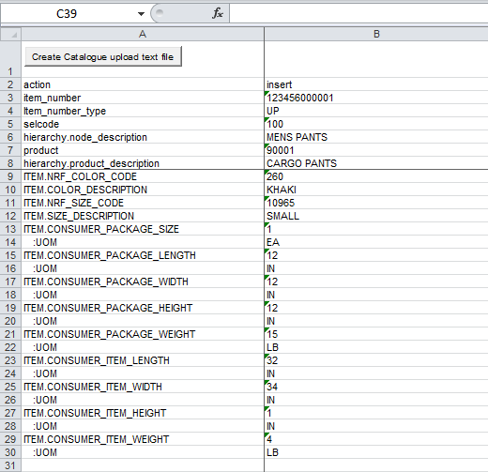
Uploading Attributes via a CSV File
Download the CSV template from the Catalogue Documentation Page
  https://catalogue.gxs.com
Fill out the CSV template offline with all of the required information
Once complete, convert the file to a text file, and save to a location on your computer.

Slide 30
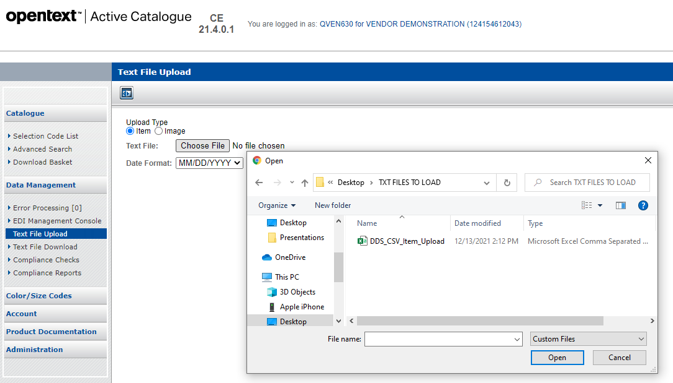
Uploading Attributes via a CSV File
Select “Text File Upload” option to retrieve your file to load to the Catalogue.

Slide 31
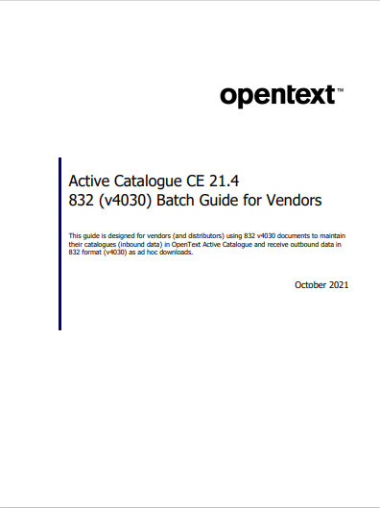
Uploading Attributes via an 832
If you are currently updating your Catalogue with an 832, you can reference the batch guide when adding additional attributes to your map.
This is available to download on the Catalogue website, as well as the Extended Attribute Guideline.

Slide 32
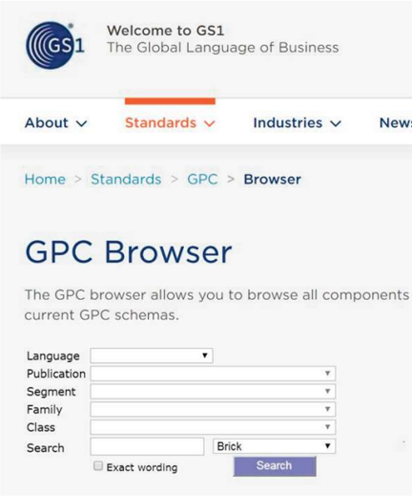
Adding GPC’s To Your Products
You can verify your GPC Brick Code through the GS1 GPC Browser
www.gs1.org/gpc/browser
Follow GS1’s instructions for looking up your products Brick Code

Slide 33
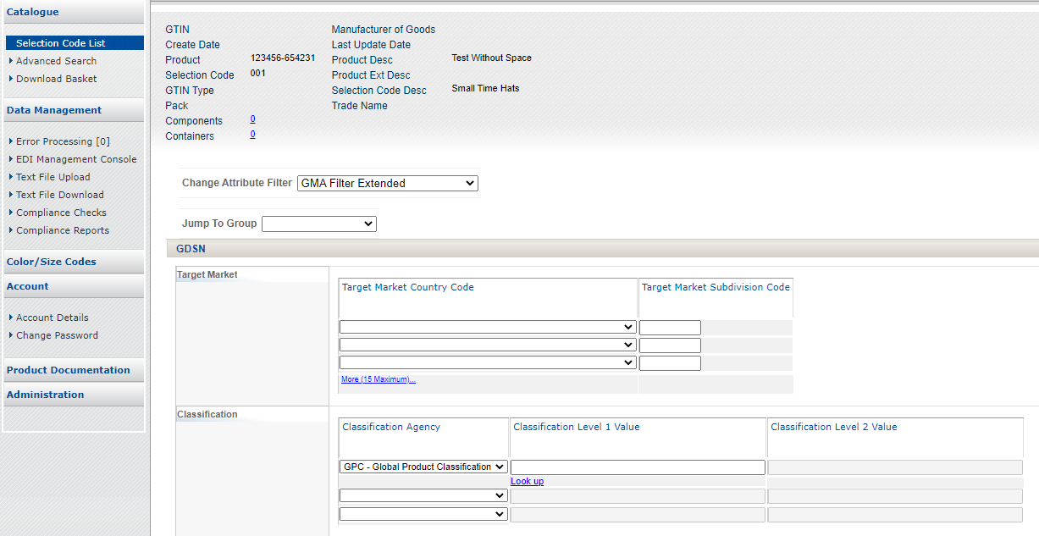
Searching GPC Codes on the Catalogue
View your product, and change Classification Agency to GPC

Slide 34
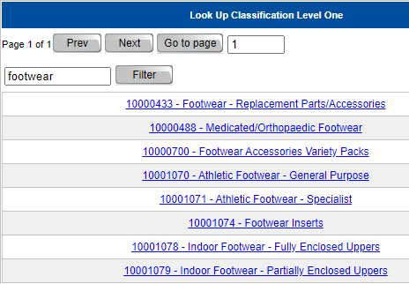
Searching GPC Codes on the Catalogue
Select “Lookup” and search for your products GPC Code

Slide 35
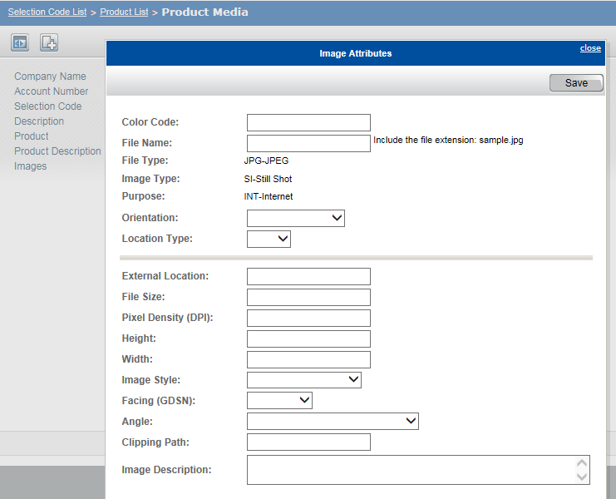
Uploading Images to your Catalogue
When loading your image information via the User Interface (UI)
  Click on the hyperlink under “Image”
  Fill in the image information
    Image File Name
    File Type (jpg)
    Location
    etc.

Slide 36
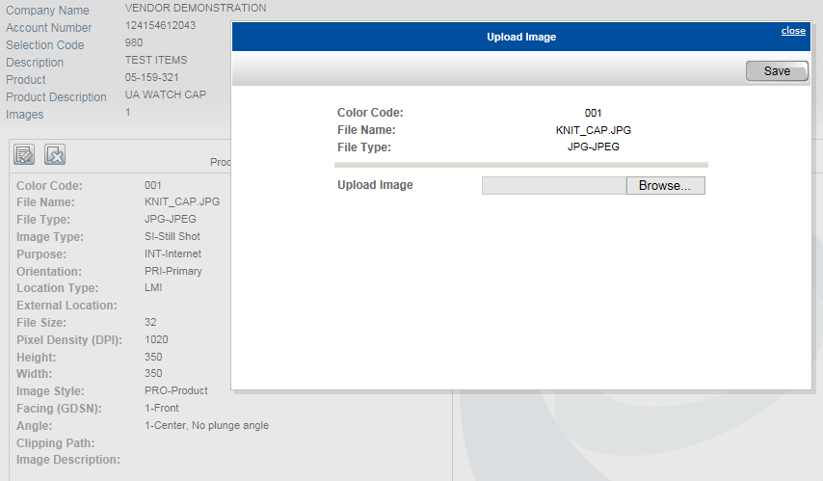
Uploading Images to you Catalogue
Once your image information is loaded, you can then load your physical image if you have not loaded one to an external FTP or URL Location.

Slide 37
Uploading Images to your Catalogue
You can load Style or Style/Color images at the Product Level, as well as multiple image facings at both levels
GTIN level supports the ability to load multiple facings
Images and Image Information are immediately available for your trading partners once you see that it has been saved successfully.

Slide 38
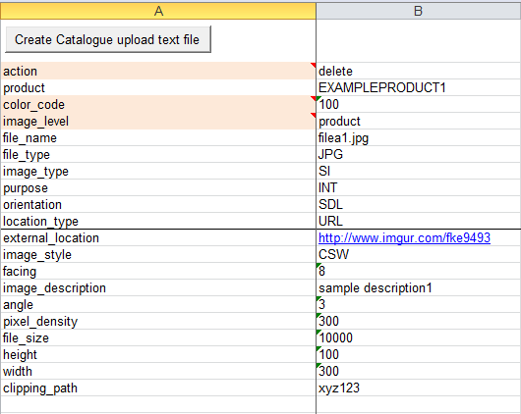
Uploading Images to your Catalogue
Using the CSV Image Template, you can see how to upload the Style/Color Level Image information to your Catalogue.
After loading the image information, you would then load the physical image separately if choose to load the image on OpenText.

Slide 39
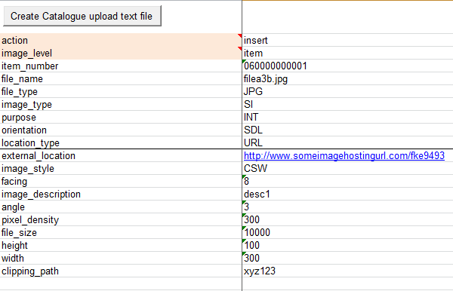
Uploading Images to your Catalogue
If you choose to load Image Attributes at the GTIN level, you can use a similar template that has most of the same information.

Slide 40
Uploading Images To Your Catalogue
If you choose to use the 832 to load your Image information, you should download the latest Batch Guide to be sure you can support all of the required segments for uploading.

Slide 41
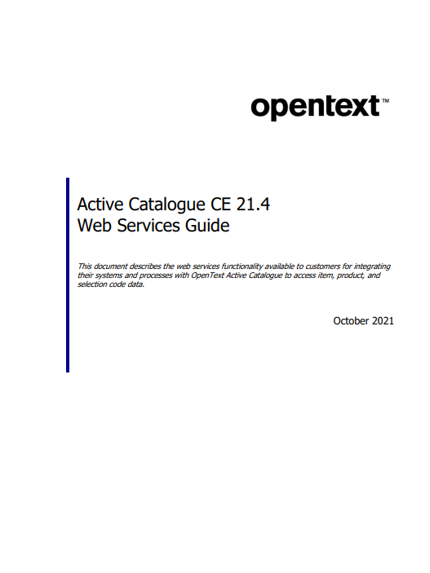
Uploading Images To Your Catalogue
If you are set up for Web Services
  Consult the Web Services Guide to make sure that you are including all of the necessary information.

