Slide 1

Thank you for joining Stein Mart & OpenText for the Image and Attribute discussion
The call will begin at approximately 2pm ET. It will run for approximately 1 hour
The lines will remain silent until the start of the call.
All lines will be muted. Any questions can be submitted via the Chat panel in the WebEx application and we’ll address after the session.
All submitted questions will be answered and posted to the Stein Mart Landing page next week in a FAQ document.
This session will be recorded, if you do not wish to be on a recorded call, the recorded session will be posted to the Stein Mart landing page next week : https://www.opentext.com/what-we-do/products/business-network/customers/steinmart

Slide 2

Agenda
Introductions from the Stein Mart & OpenText team
Stein Mart partnering with OpenText
Extended Attribute & Image Overview
OpenText Active Catalogue Overview
  About the Active Catalogue
  Various ways to load the Attributes & Images
Stein Mart’s Specific Call-Outs
Documentation and Support
Q & A

Slide 3
Speaker Introductions
  Robin Joseph – VP / DMM
  Jake Divjak – Customer Manager
  JDivjak@opentext.com
  Don Wiener – Director Retail Industry
  Dwiener@opentext.com

Slide 4
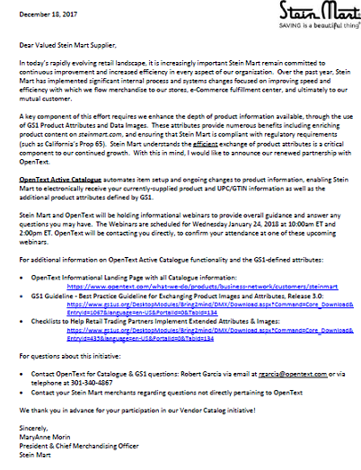
Stein Mart’s Expectations
Requirements:
Populate all relevant product attribute information in the OpenText Catalogue following the GS1 ‘Voluntary Guidelines for Exchanging Extended Attributes & Images for Ecommerce’
Ensure all items are set up in OpenText Catalogue with appropriate attributes prior to ship date.
Start working with OpenText to Learn the Uploading Process
Additional Functionality:
Provide product images in accordance with the GS1 Guidelines
Stein Mart will have the ability to pull Extended attributes from the OpenText Catalogue into our master data repository, which will be especially beneficial to ECOM.
Visit the OpenText Landing Page created especially for Stein Mart’s initiative: https://www.opentext.com/what-we-do/products/business-network/customers/steinmart

Slide 5
Business Drivers
Business Leaders from all areas are asking for the same thing…More Product Data!
  E-com
    Need product attributes to enhance our search engine capabilities on the Web
    Need details on products to meet consumer demand
    Need automated process to retrieve images and copy from our suppliers
      Spending too much time chasing images and copy
      Can’t publish to the Web without it. Affecting speed to market
  Supply Chain
    Need information to label package hazardous for shipping
    Need dimensional/weight information to maximize carton size for shipping
  Merchants
    Need to see image of item at time of order to review product
    Need attributes for enhanced business intelligence analytics
  Stores
    Need image to help locate item for consumer
    Need image for promotional/advertising event setup

Slide 6
Extended Attribute & Image Overview

Slide 7
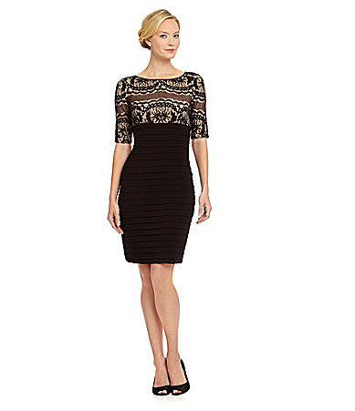
E-commerce Item Set-up Challenge
Ordering a dress/PO create:
Style Number
20 digit Style Description
Color Description
NRF Color Code
Size Description
NRF Size Code
UPC Number
Selling a dress:
Adrianna Papell
Boat neckline
Elbow sleeves
Lace bodice
Banded skirt
Keyhole back
Button-and-loop closure
Concealed back zipper
Polyester/spandex
Dry clean
Imported
Lots of images

Slide 8
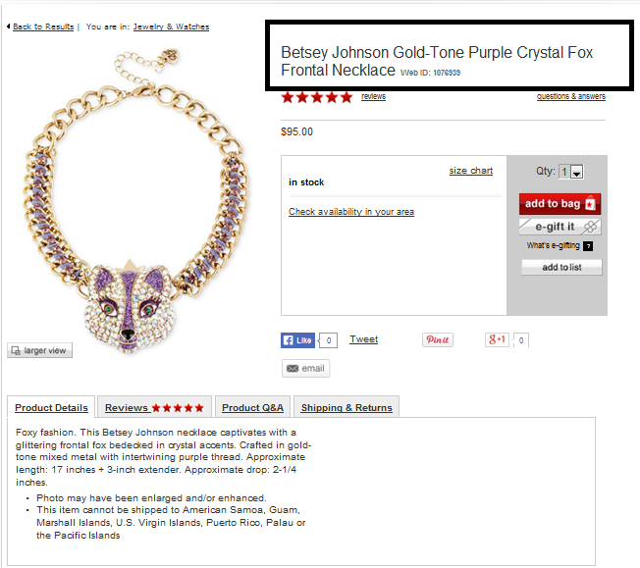
Need for Extended Attributes
Missing “Imperial” from description.

Slide 9
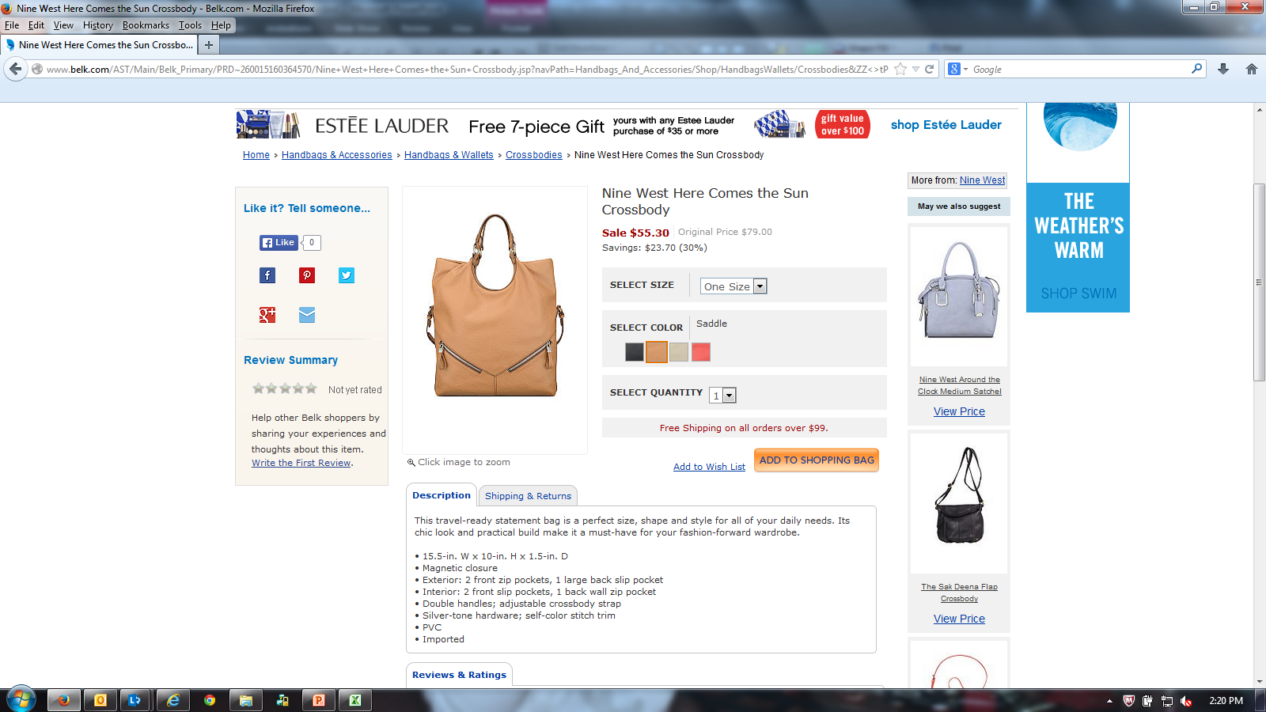
Need for Images
Additional images needed to show consumer the inside/outside of bag
Consumers would also like to see a mannequin shot in the picture
Visibility to the crossbody strap

Slide 10
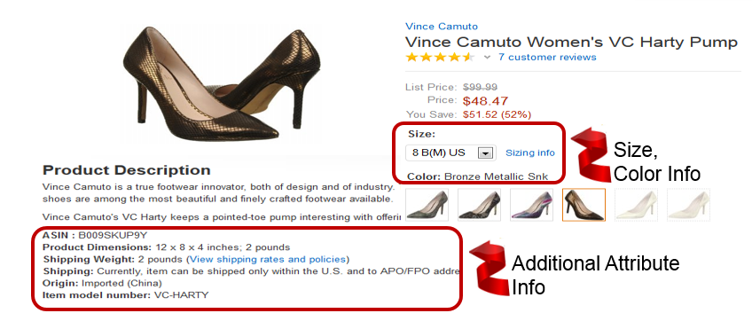
Increase Sales
Imagery
Complete information enables the customer to be better informed before purchase.

Slide 11
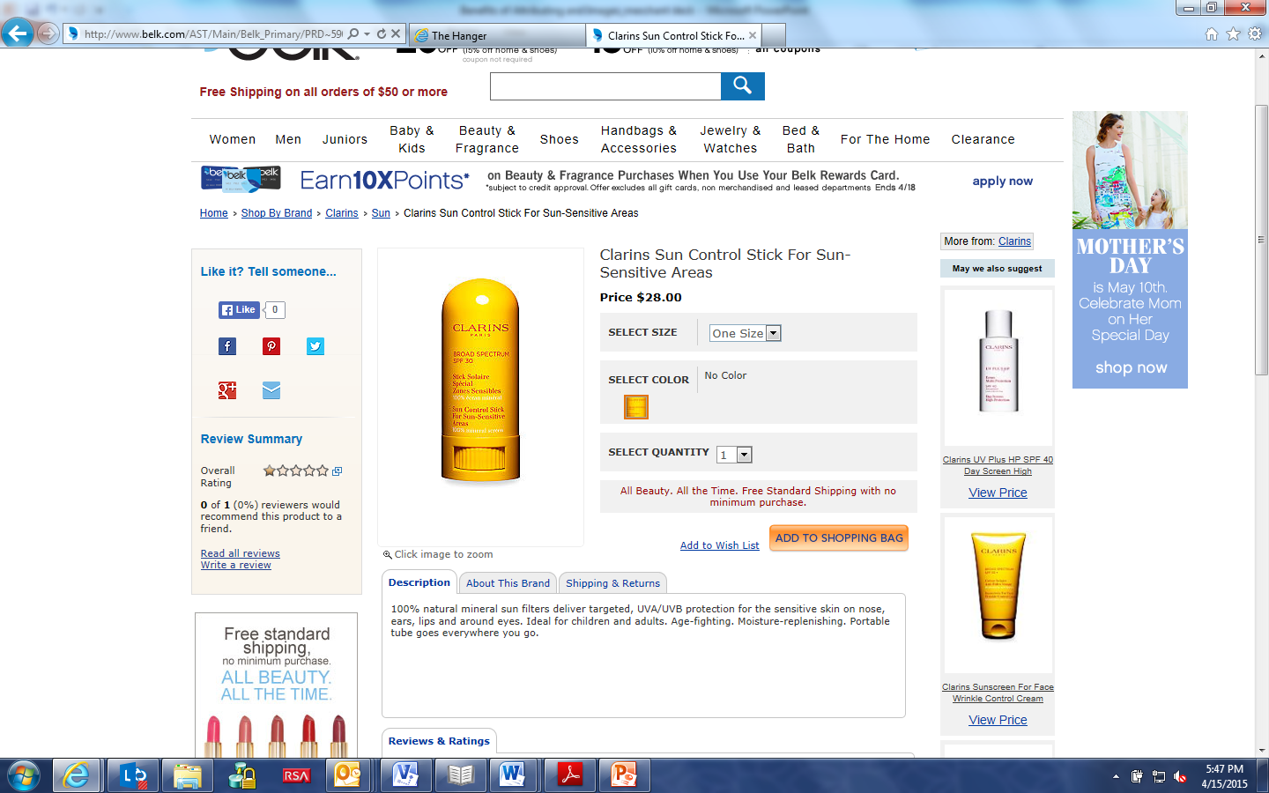
Content supports tax & legal requirements
Imagery
An SPF attribute on this product is necessary to support state tax laws
Note: Item is not populated with the actual size. Customer wants to know how many fluid ounces they get for the price

Slide 12

Current Business Process for Most Retailers
Creating Multiple Spreadsheet Formats
Shooting Multiple Image Formats
Running Around the Building Gathering Data
Email Attachments
Snail mail
DVD/CD
Drop Box
Manual FTP
*2 to 4 Additional Weeks to Start Selling on e-commerce Site

Slide 13

Solving the Omnichannel information challenge
Extended Attributes and Images
  Additional attributes are needed to support Omnichannel processes
  Consumers demand more data and images to make a buying decision
  Catalogue provides central point to aggregate all data
Core Attribute Examples:
  GTIN / UPC
  Product Description
  NRF Size / Color Codes and Descriptions
Extended Attribute Examples:
  Country of Origin
  Marketing Message
  Care Instructions
  Does Not Contain
  Packaging Dimensions

Slide 14
Solving the Omnichannel information challenge
2010 Key Retailers and Vendors realize with continued growth of e-commerce they need for additional product information and Images
Partnered with GS1 to develop guidelines
GS1 Extended Attribute and Image Workgroup Objectives:
  Collaboration with retailers and vendors to develop common set of attributes and image guidelines
  Develop industry guidelines
  Industry Education
May of 2013 – GS1 Release 1 of Extended Attribute Guideline
May of 2015 – GS1 Release 2 of Extended Attribute Guideline
July of 2017 – GS1 Release 3 of Extended Attribute and Image Guideline

Slide 15
GS1 Extended Attributes – Release 3
Released July 2017
  Added 127 new attributes bringing total available attributes to 193
  Combined Extended Attribute and Image Guidelines
  Includes EDI information for images
  Added guidelines for Montage and 360 images
Attributes that do not apply to a item, will not need to be populated in the Catalogue
  Example #1 = Fur Animal Name- if fur isn’t present on item, do not populate.
  Example #2 = Heel Height- doesn’t apply to a shirt, no need to populate.
Notes:
A Montage is the physical over layering of distinct images to create a final digital image. This process allows for a composite to be created with the future possibility of reconstruction without having to return to studio for correction, should an element be added or removed.

Slide 16













Increasing speed to market
Retailers with extended attributes & image programs
*
*
*
*
*
*
*
*
*
*
Retailer exclusively utilizes OpenText Active Catalogue

Slide 17
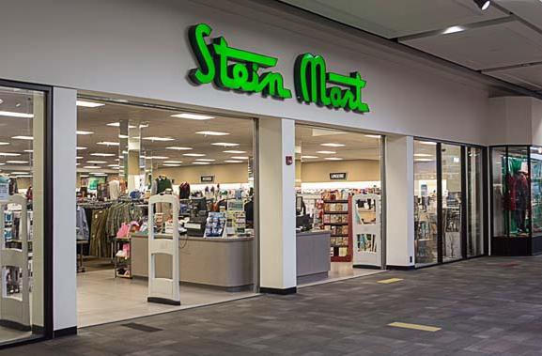








OpenText - Retail’s leading provider of B2B solutions
Market Leadership
90% of Fortune 500 General Merchandise
58% of STORES100 Retailers
Retail Expertise
Complete Support for Entire Value Chain/Procure to Pay Process
Leading provider of data synchronization solutions
Solutions
Data synchronization
Complete B2B solutions for entire trading community
Deductions Management – Business Compliance for B2B data transactions
Notes:
Retail and Consumer Products is GXS largest industry sector and our largest investment area
GXS recognizes three key challenges amongst retailers:
Building Customer Loyalty
Industry Pain Points - 13% Out of Stock on Promotions; 8% Out of Stock on Private Labels
As a result, retailers are Increasing Promotions, Loyalty Cards, Private Label Brands, New Formats
Enhancing Supplier Relationships
50% of Invoices have Deductions
<20% of Suppliers receiving demand data
As a result, retailers are promoting Supplier Portals – CPFR, ECR, VMI
Streamline Operations -
< 20% of Suppliers are Enabled
EDI Mandates, Centralized Buying, Scan Based Trading
Additional Customer Statistics
100% of top 20 Retailers in the UK
Country Data Pools in Canada, Australia/New Zealand, Spain, Hong Kong and Taiwan
Strength in both the new GS1 data synchronization standards and legacy apparel/department store (VICS-based catalog standards)
Over 4000 Data Synchronization customers
Sample Customers: Walgreens, JSainsbury, Nike, Target, Loblaws, Albertson, Proctor&Gamble, 3M, Levi’s BestBuy, Dixon’s, Kohl’s, LizClaiborne, ToysRUs, Tesco, Cargill, May Company, Lowe’s, Kraft, JCPenney, Woolworths, Argos HarrisTeeter, RiteAid, OBI, BedBath&Beyond, B&Q OfficeMax, Boots, Iceland, SaraLee, Jones Apparel Group, Kmart, Gottschalks Marks&Spencer, HEButt

Slide 18
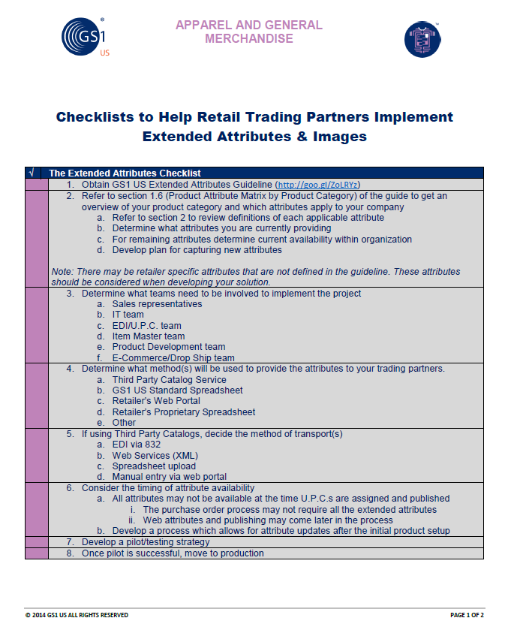
Preparing to Load Items into OpenText
Visit the GS1 Attribute and Image website for information that can help you implement a strategy within your company:
https://www.gs1us.org/DesktopModules/Bring2mind/DMX/Download.aspx?Command=Core_Download&EntryId=435

Slide 19

Additional Readings About the Initiative
To see how another company has implemented the use of images, J.Renee’ and GS1 authored a white paper that is very informative and can be found at the below URL:
https://www.opentext.com/file_source/OpenText/en_US/PDF/opentext-third-party-case-study-jrenee-en.pdf

Slide 20




OpenText/GXS Retail Panel
Many different retailers participate across different segments of the industry.
Over 120 participants representing over 50 retail industry leading companies
Regular conference calls - annual meeting at Enterprise World
Common goals:
  Understanding of required attributes and their definitions.
  Collaboration with retail industry leaders
  Partnership with GS1

Slide 21
OpenText Active Catalogue Overview

Slide 22
OpenText/ GXS Active Catalogue
What is the Active Catalogue:
Retail industry’s leading product data synchronization application
Allowing marketers, manufacturers and suppliers to share their latest product information such as price, style, color, size and more than 600 additional product attributes with retailers.
Provides extensive data validations and comprehensive data attribute support. OpenText Catalogue enables better management of new item introductions and item maintenance processes
Key Statistics:
Over 210 million items stored
Over 600 attributes
Over 6,000 suppliers/manufacturers/distributors
Over 200 retail hubs

Slide 23
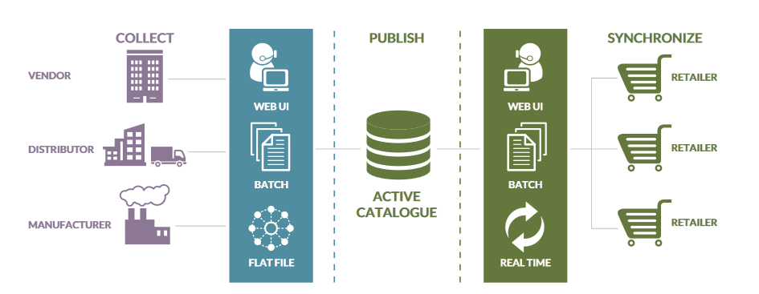
OpenText Active Catalogue Overview
Retail’s leading data synchronization solution
  Utilized by 90% of Fortune 500 General Merchandise retailers
  Over 210 million unique items
  Over 200 retailers and 6000 suppliers
Notes:
centralized single source of information across the retail supply chain

Slide 24
Preparing to Load Attributes and Images
Understand the required attributes
  Review Trading Partner and OpenText image and attribute information
Obtain the required attributes
  Review online resources (Trading Partner Landing Page or online OpenText Catalogue Documentation) to identify what attributes you should be providing
Transform your data into the industry standard/Catalogue attribute format
  Guides and Templates available at: http://www.OpenText.com/catalogue_extended_attributes
  Update your processes to support the required attributes (EDI maps, User Interfaces, etc.)
  Guides and Templates available at OpenText Trading Partner Landing pages or: http://www.OpenText.com/catalogue_extended_attributes

Slide 25
How Vendors Use the OpenText Catalogue
Vendors can access their catalogues in a number of ways
    832
    CSV
    Web User Interface (UI)
    Web Services
No method is mutually exclusive. Most vendors use a combination of methods to publish and update their item information.
If using OpenText to host images you must use
    Web Services
    User Interface (UI)
EDI 832 does not support loading physical images
    Supports the Image URL and image information

Slide 26
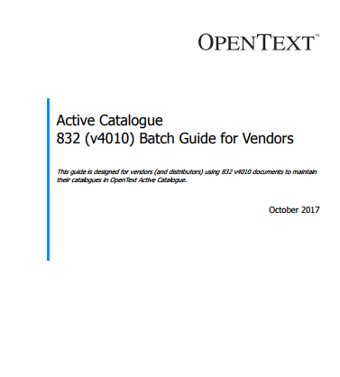
Uploading Attributes via an 832
If you are currently updating your Catalogue with the EDI 832, you can reference the Batch guide when adding additional attributes to your mappings.
This is available to download on the Catalogue website, as well as the Extended Attribute Guideline.
Under ‘Documentation’ section of the Catalogue User Interface, we have a Cross Reference Spreadsheet laying out all of the segments.

Slide 27
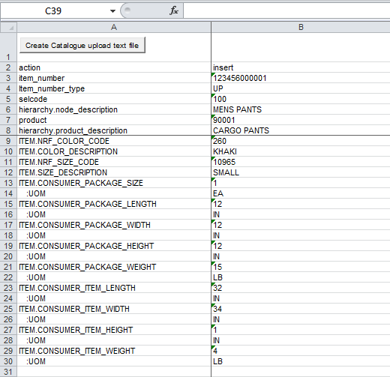
Uploading Attributes via the CSV template
In the coming weeks, you’ll be able to download the CSV template from the Trading Partner landing page - Click Here
Fill out the CSV template offline with all of the required information.
Once complete, convert the file to a text file, and save to a location on your computer.
*Two separate.csv templates:
  Attributes
  Images

Slide 28
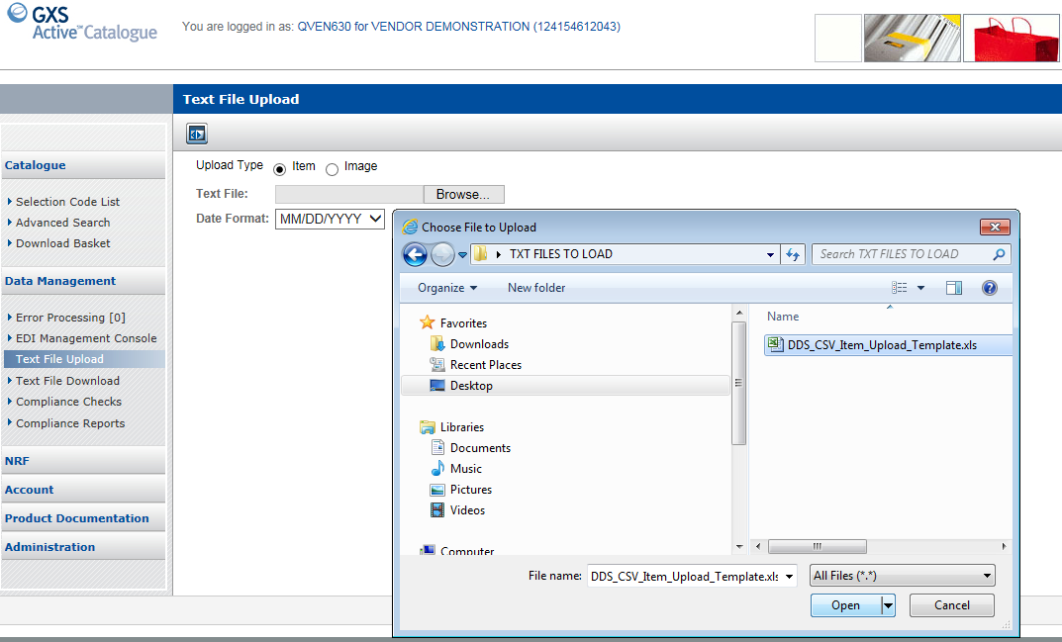

Uploading Attributes via a CSV File
Select “Text File Upload” option to retrieve you file to load to the Catalogue.

Slide 29
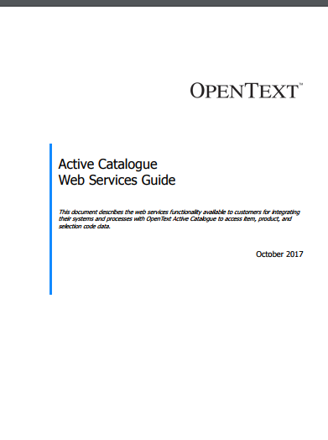
Uploading Attributes via Web Services (XML)
If you are currently utilizing Web Services
  Consult the Web Services Guide to make sure that all of the necessary information is included.
  We also have the Web Services FAQ document under the ‘Documentation’ Section within the Catalogue’s User Interface
  Under ‘Documentation’ section of the Catalogue User Interface, we have a Cross Reference Spreadsheet laying out all of the Web Services (XML) tags

Slide 30
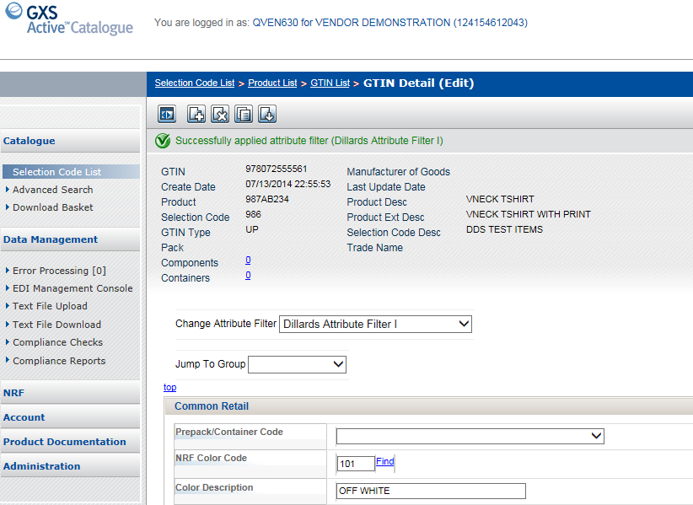
Uploading Attributes via the Web (User Interface)
Select the appropriate Stein Mart Filter to ensure you’ve populated the needed attributes
Under the ‘Documentation’ Section on the left-side Menu, you will find the User Interface Guideline
We also have a Cross Reference Spreadsheet laying out all of the GS1 attributes vs. how they’re labeled in the User Interface
Change filter to desired Trading Partner

Slide 31
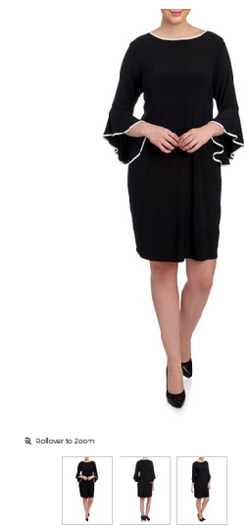
Uploading Images in your Catalogue
  The Catalogue can support your physical images and/or your image attribute information.
  The physical image can be loaded to the Catalogue by:
    Web Services
    Web User Interface
  The image URL and information can be loaded to the Catalogue by:
    Web Services
    Web User Interface
    832
    CSV File Template

Slide 32
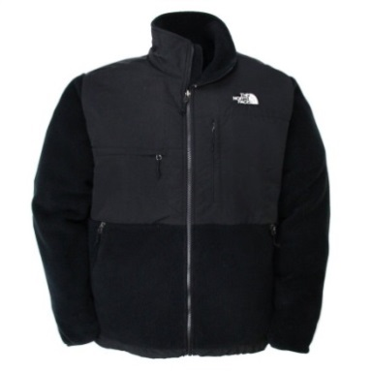
Uploading Images in your Catalogue
  What is the difference between loading a Physical Image or loading the Image URL ?
    A Physical Image is the actual image of the product loaded to OpenText
      Directs the Retailers to the OpenText site to pull images
    The Image URL is the information of where the image is hosted
      Your FTP or URL location
      Image Name
      Facing
      Directs the Retailer to your ‘hosting site’ to pull images

Slide 33
Uploading Images in your Catalogue
When you choose to load or update your images or image information via the Catalogue, you should first download the following guides:
  GS1 Image and Attribute Guide http://www.OpenText.com/catalogue_extended_attributes
  OpenText Brower Interface User Guide for Vendors
    https://catalogue.OpenText.com
  OpenText Image Actions Template for Catalogue Image Data for CSV
    https://catalogue.OpenText.com
  OpenText Web Service Guide
    https://catalogue.OpenText.com

Slide 34
Stein Mart’s Specific Call-Outs

Slide 35
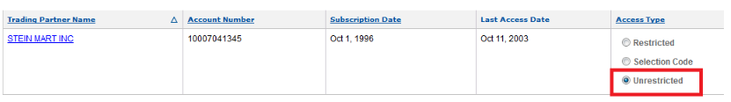
Granting Access to Stein Mart
Stein Mart is asking that “Unrestricted” access be granted :
  Stein Mart Catalogue Account ID = 010007041345
  A step by step document on ‘How to Grant Access can be found in the ‘Further Information and Resources’ section on the Stein Mart landing page located at:
  https://www.opentext.com/what-we-do/products/business-network/customers/steinmart

Slide 36
Stein Mart Setup Call-Outs
Stein Mart will need to link your Vendor Number to your Catalogue Account number. You’ll need to send your Catalogue Account number to: edi@steinmart.com
Items and packs must be set up timely and accurately in the OpenText Catalogue in order to avoid downstream supply chain issues.
All UPC/ GTIN item setups must be complete in OpenText a minimum of 2 weeks prior to orders being written and released
Correct NRF Size codes that apply to the sizing for the item using correct NRF size chart for the product you are selling. Make sure to look at both the primary and secondary description to ensure you are using the correct code.
Reuse of GTINs/ UPCs must be per GS1 standards. *NOTE = As of December 2018, re-use of GTINs will not be permitted per the new GS1 Guideline

Slide 37
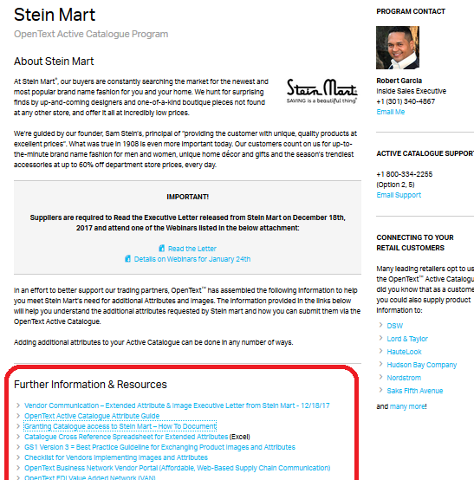
Stein Mart’s Landing Page
Visit the OpenText Landing Page created especially for Stein Mart’s ECOM Attribute & Image initiative:
  https://www.opentext.com/what-we-do/products/business-network/customers/steinmart

Slide 38

Stein Mart's Attribute/ Image Letter:
  Stein Mart's Extended Attribute/ Image Letter
Stein Mart's Informational Landing Page:
  Click Here
OpenText / OpenText Extended Attribute and Image informational page:
  http://www.OpenText.com/catalogue_extended_attributes
OpenText Catalogue Documentation:
  https://catalogue.OpenText.com/QRSGUI/jsf/login/login.jspx
GS1 Apparel & General Merchandise Page:
  http://www.gs1us.org/industries/apparel-general-merchandise
OpenText Active Catalogue Support:
1-800-334-2255 Options 2,5,2
OR
Email Catalog Customer Support: cataloguesupport@opentext.com
OpenText/OpenText Contacts:
Jake Divjak – Customer Manager
JDivjak@opentext.com
Don Wiener – Director Retail Accounts
Dwiener@opentext.com
Robert Garcia– Sales Executive
rgarcia@opentext.com

